Slide 1


16th Aluminium Raw Materials Summit
May 28-29, 2026 Haikou, China
Alumina Industry Development and Bauxite Demand in India
David Paris
Chief Operations Officer – Trading
Rescom Mineral Trading

Slide 2

Based in Switzerland and the UAE, Rescom is a mineral and metal conglomerate, operating predominantly in the GCC and Asia-Pacific regions with five decades of experience and strategic investments across the spectrum in mining, trading and processing.
KCap, as the investment arm of Rescom, facilitates collaborations, JVs and strategic investments in industry opportunities.
Rescom’s holding company is in Zug, Switzerland, whilst our leadership and professional team operate the business from our headquarters in Dubai, UAE.
Our international footprint spans three continents across Switzerland, UAE, India, Kuwait, Guinea and Indonesia. We are also one of 3 owners of the Pioneer (Anrak) alumina refinery in India.

Slide 3
India’s 2025 Aluminium Industry Balance
India’s Aluminium production currently ranks as 2nd largest in the world by country
Additional Imports of primary and secondary aluminium add another to 60% on top of domestic production
2025 Alumina production operating about 2 Mtpa below installed capacity, initially due to imported bauxite availability.
Many Indian refineries are built close to good quality bauxite mines enabling low cost production
Current Indian bauxite reserves are ~600 Mt proved and probable
2025 | Quantity (Mt) | % Consumption
Bauxite Consumption Production Imports Exports Alumina Consumption Production Imports Exports Aluminium Production Imports Scrap Imports Exports | 26.0 20.2 5.8 0 8.2 8.9 1.5 2.2 4.3 0.5 2.1 2.5 | 78 12 0 108 18 26

Slide 4
India’s Aluminium Industry Growth (5 year)
Aluminium production in India is forecast to grow by ~3.5 million tpa within the next 5-6 years.
Secondary Aluminium capacity is forecast to grow another 1 million tpa primarily through improved domestic collection bringing total industry capacity to 10.9 million tpa by around 2030
Alumina expansion and debottlenecking project should bring India’s alumina capacity to 15-16 million tpa which is roughly sufficient to support the projected 7.8 million tpa metal production, with the balance supported by secondary aluminium
By 2030, Bauxite requirements are forecast to reach 45 million tpa
Note that 2025 Vision document of Govt of India (2025) forecasts domestic aluminium demand to reach 8.5 million tpa plus export growth to 3.8 million tonnes.

Slide 5
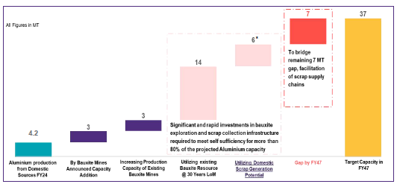
India’s Aluminium Industry Growth (20 year)
Vision Document of Govt of India sees India’s aluminium industry growing significantly based upon increased per capita utilization from 3.5kg to 12kg by 2047
That vision would take the Indian aluminium industry to 37 million tpa including 28 million tpa domestic consumption.
Ref: Vision Document on Aluminium Sector. Govt of India (2025)
Factoring in secondary aluminium and imports, it follows that alumina production would need to grow by an additional 27 million tpa and bauxite by around 80 million tonnes
Even with that, there are gaps. Nonetheless, India has an ambitious vision for aluminium

Slide 6
Global Bauxite Quality
While India’s ambitions can be supported by its domestic resources, globally, bauxite quality is deteriorating
Since 1990’s, the BAR for major traded bauxites has declined from ~2.1. Today, BAR in the major traded bauxites is around 2.7 and, in some cases, approaching 3. Also, the variation in reactive silica content amongst different sources has more than doubled.
For much of the current traded bauxite market, freight cost is greater than the bauxite. When 65% of the product being shipped goes to waste, this is significant
Refineries built close to bauxite sources will have an increasingly significant cost advantage over those transporting long distances

Slide 7
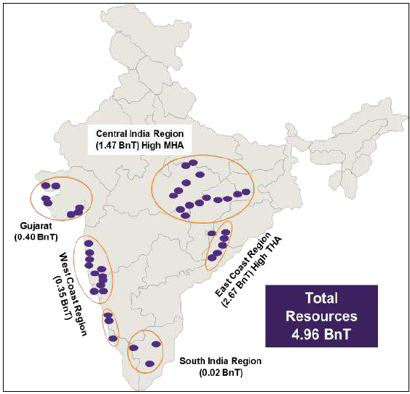
India’s Bauxite Requirements
Size of India’s Bauxite resource ranks it 8th in the world by Country. As of 2025, India had bauxite reserves of 600 Mtpa out of a 5 billion mt resource.
Government bauxite definition currently excludes some lower grades which are likely suitable for alumina production
The resource is predominantly Gibbsitic, particularly in the central and eastern regions. Around 75% of the current resource is also in that region
Increased exploration to convert Resources to Reserve will need to be prioritised
Ref: Vision Document on Aluminium Sector. Govt of India (2025)

Slide 8
Conclusions
India has an ambitious vision for Aluminium and is beginning to develop rapidly
The expansion plans are supported by India’s bauxite resources, although the rate of conversion to reserves needs to be prioritized
Over the next 5 years, India’s aluminium industry is forecast to be 10.9 million tpa, including imports and expanded secondary aluminium capacity
Expansion of alumina production and bauxite mining will expand to support the forecast growth. Imports of alumina and bauxite are likely to continue to support domestic production.
India will continue to participate in export markets for both aluminium and alumina.

