Slide 1




Report on The Alumina Supply in Shanxi and Bauxite Demand Structure
Speaker: Liu Dan
Date: 2026.5

Slide 2
LOGO
LOGO
LOGO
LOGO
LOGO
Contents
Current operational status of alumina production in Shanxi
Situation of bauxite usage by alumina refineries in Shanxi
Position of Shanxi's alumina production cost within the national context
Current supply status and trends of domestic bauxite in Shanxi
01
02
03
04

Slide 3
Current operational status of alumina production in Shanxi
PART
01

Slide 4
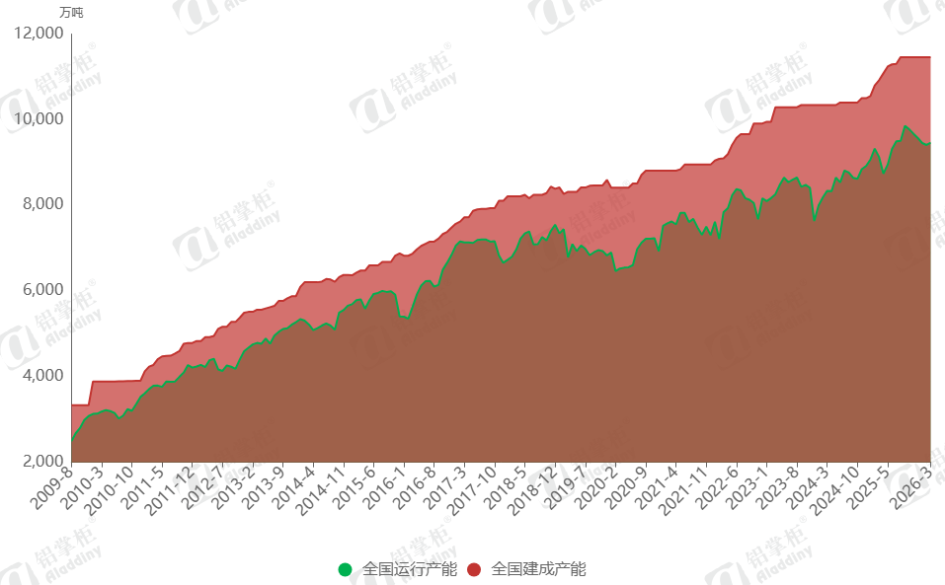
1
Current operational status of alumina production
Figure 1: Current Operational Status of Alumina in China
Since 2009, the national operational alumina production capacity has been increasing, with the main growth coming from the commissioning of new alumina refineries in coastal areas.
(National Operational Capacity)
(National Installed Capacity)
References: ALD

Slide 5
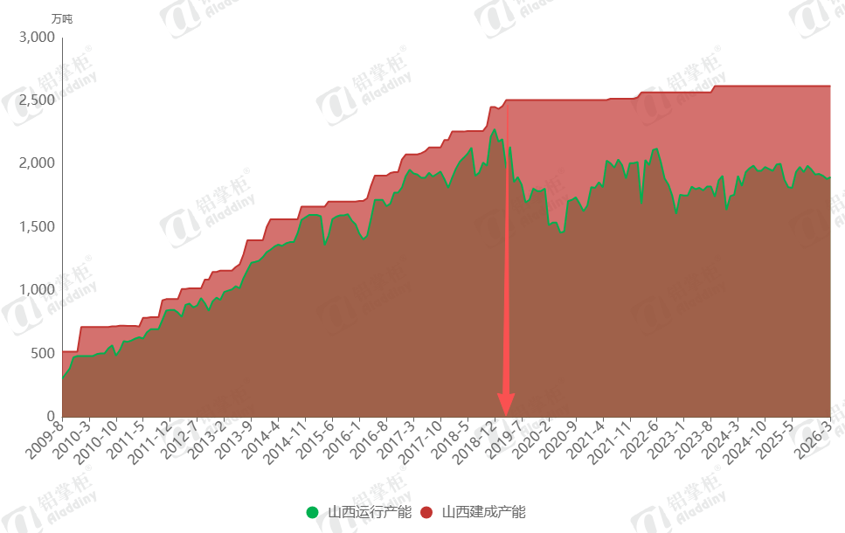
1
Current operational status of alumina production in Shanxi
Figure 2: Current Operational Status of Alumina in Shanxi
In contrast, the operational status of alumina production in Shanxi has been fluctuating within a range. As of April 2026, Shanxi's installed alumina capacity reached 26.20 million tons, while its operational capacity stood at 19.00 million tons, with an operating rate of only 72.5%. A fundamental change occurred in Shanxi's alumina capacity operation in 2019. Due to the tightening supply of domestic bauxite, alumina refineries at that time carried out large-scale technical modifications. Since 2019, Shanxi has officially entered a state of using both domestic and imported bauxite simultaneously.
(Shanxi Operational Capacity)
(Shanxi Installed Capacity)
References：ALD

Slide 6
Position of Shanxi's alumina production cost within the national context
PART
02

Slide 7
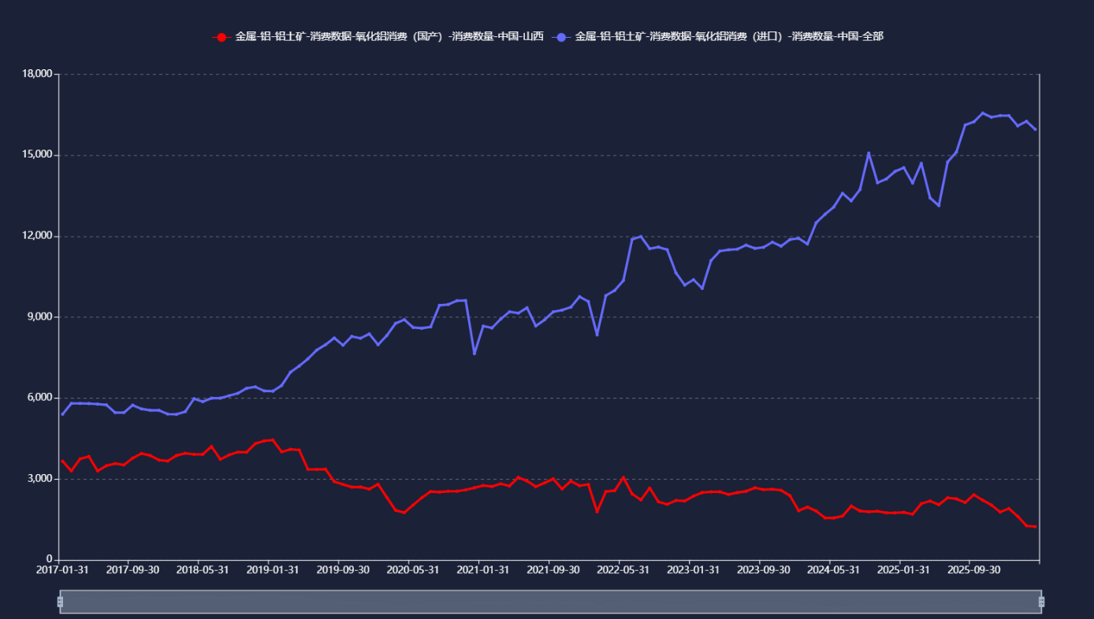

2
Changes in the usage of imported and domestic bauxite in Shanxi
Figure 3: Consumption of Imported and Domestic Bauxite in Shanxi (kt)
Table 1: Usage of Imported Bauxite in China's Main Alumina Producing Areas
Unit：10kt
Date | Shandong | Shanxi | Henan | Guangxi | Guizhou | Chongqing | Inner Mongolia | Hebei
Jan.-Mar., 2026 | 2,190 | 804 | 246 | 695 | 24 | 320 | 53 | 550
2025 | 8,357 | 2,844 | 1,000 | 2,300 | 148 | 1,171 | 251 | 2,066
References: Asian Metal
According to Asian Metal, as of March 2026, Shanxi had 12 operating alumina refineries with a total capacity of 18 million tons. Among these, over 12 million tons of capacity use imported bauxite. Only one refinery uses only domestic bauxite, five use only imported bauxite, and the rest use a mix of both, depending on supply conditions, costs, and other factors.
In 2025, Shanxi used 28.44 million tons of imported bauxite, ranking second in the country, with the vast majority being Guinean bauxite. In the first three months of 2026, the usage of imported bauxite reached 8.04 million tons. In terms of trend, the usage of imported bauxite is increasing and remains at a high level. It is estimated that the full-year usage of imported bauxite in Shanxi in 2026 will reach 28–30 million dry metric tons, still ranking among the top. However, after the new capacity in Guangxi is fully released, Guangxi's imported bauxite usage may jump to second place.

Slide 8
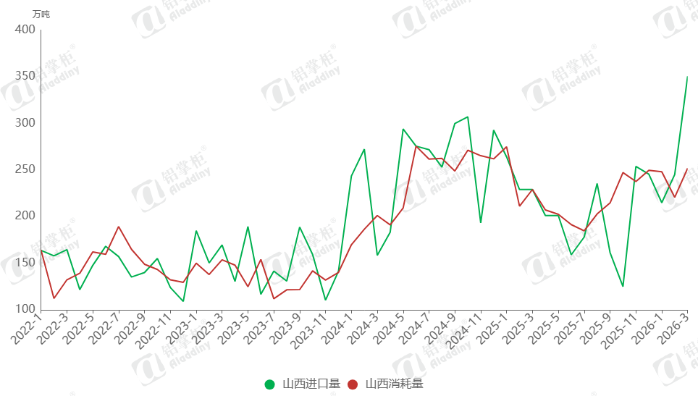
2
Changes in the Usage of Imported and Domestic Bauxite in Shanxi
Figure 4: Import Volume and Consumption of Bauxite in Shanxi
Since 2019, alumina refineries in Shanxi and Henan have carried out large-scale technical upgrades, followed by continuous process improvements to adapt to different ores. Shanxi has the most diverse bauxite usage structure in China. Most refineries still rely mainly on local ore, so early upgrades were not fully comprehensive—much capacity still cannot completely shift away from domestic bauxite. However, imported ore can be used through blending.
Based on current alumina prices and the ore price gap, imported bauxite now has a slight cost advantage (domestic ore has lower grade, tighter supply, and higher prices). Therefore, Shanxi's imported bauxite usage has been rising month by month this year. But this does not mean the import share will keep increasing indefinitely. While using more imported ore, refineries are also actively stockpiling domestic ore to ensure supply security and stable production.
(Shanxi Imports)
(Shanxi Consumption)
References: ALD

Slide 9
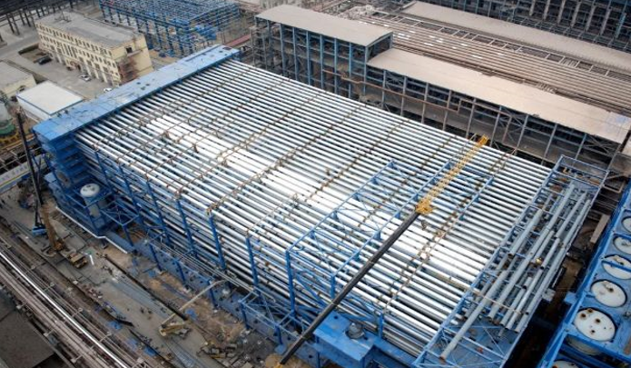
2
Changes in the Usage of Imported and Domestic Bauxite in Shanxi
Currently, most alumina refineries in Shanxi Province are continuing to advance production line technical transformations to reduce costs. The core direction is to broaden raw material adaptability and enable flexible switching between ore sources. The process routes mainly present two types of adjustments: First, transforming high-temperature production lines originally designed for domestic bauxite into low-temperature lines suitable for Guinean bauxite. Second, further upgrading low-temperature lines that already use imported bauxite to also accommodate high-alumina-to-silica-ratio (high A/S) imported ores.
The site of Chalco Shanxi New Materials Co., Ltd.'s 1 Million Ton Alumina Energy-Saving and Efficiency-Upgrading Renovation Project

Slide 10



2
Types of Imported Ores Used in Shanxi
Currently, Shanxi's imported bauxite is mostly from Guinea, accounting for about 90%, with additional supplies from Australia, Turkey, Brazil, and Montenegro.
Guinea bauxite is mainly low-temperature gibbsite ore. It can be used alone or blended with domestic ore. With abundant supply and low caustic soda and energy consumption, it is the main imported source for Shanxi's alumina refineries. However, Guinea ore grades are gradually declining. For inland refineries like those in Shanxi, the cost gap between high-grade and low-grade ores is much larger than for coastal plants, mainly because higher ore consumption increases the logistics cost of long-distance transportation.
Australian bauxite is less compatible with Shanxi's processes than Guinean ore. Its organic carbon content (0.2–0.5%) negatively affects digestion, settling, decomposition, and evaporation, requiring special organic and carbon removal systems. Without such systems, using Australian ore increases production risks. Some plants use it only intermittently, switching back to domestic ore to manage organic impacts, but this still disrupts production continuity, affects alumina quality, and may raise overall costs.
Overseas diasporic bauxites such as Turkish and Montenegrin ores are mainly used as blending materials with domestic ores. By virtue of their high aluminum-to-silicon ratio, they help raise the overall grade of the mill feed, and their use is relatively common among Shanxi enterprises. However, the quality of Turkish ore varies significantly: high-grade resources are scarce, while low-grade ores have high silicon and titanium content and low extraction rates. Although such ore types help diversify the raw material structure and improve blending flexibility, their limited overall supply makes it difficult to fundamentally alleviate the regional supply-demand imbalance for ores.

Slide 11
Position of Shanxi's alumina production cost within the national context
PART
03

Slide 12
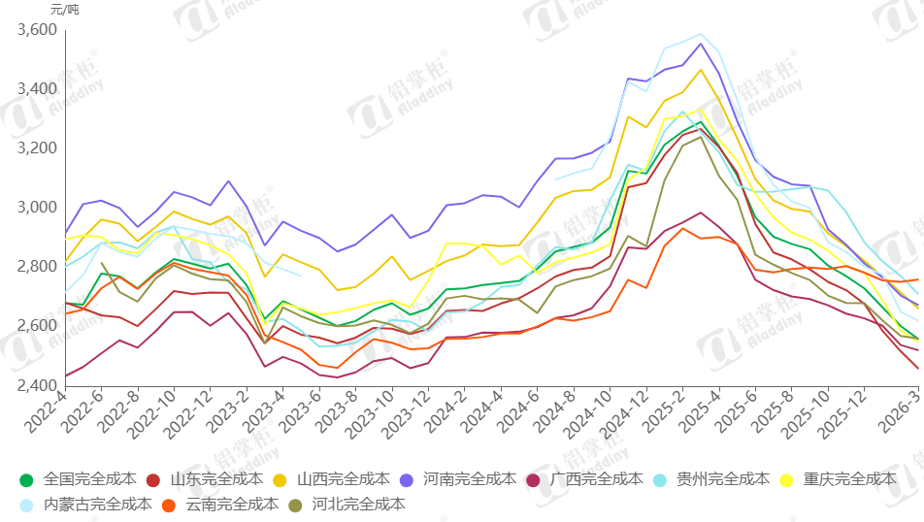
3
Position of Shanxi's alumina production cost within the national context
Shanxi's alumina production cost ranks fourth highest among the nine major alumina production regions, behind only Guizhou, Yunnan, and Henan. Although the average cost in Guizhou is high, the volume of high-cost capacity there is relatively small. In contrast, both Shanxi and Henan have consistently high costs across the board.
Costs are rising for two main reasons. For imported ore, the long transport distance from the port to the factory results in very high freight costs. For domestic ore, competition for limited supplies keeps prices high, and falling local ore grades add further cost pressure.
Table 2: Range of Total Freight Costs from Port to Plant for Major Alumina Production Areas
Figure 5: Full Cost Comparison Across Major Domestic Alumina Producing Regions
Province | Freight range (RMB/t)
Shandong | 10–64
Shanxi | 60–110
Henan | 92–110
Guangxi | 10–90
Guizhou | 150-180
Hebei | 10–20
National Average Shandong Shanxi Henan Guangxi Guizhou Chongqing
Inner Mongolia Yunnan Hebei

Slide 13
Current supply status and trends of domestic bauxite in Shanxi
PART
04

Slide 14
4
Current supply status and trends of domestic bauxite in Shanxi
Impact of the New Mineral Resources Law on Bauxite Investment and Production in China
A
On July 1, 2025, the new Mineral Resources Law takes effect, bringing major changes to China's bauxite industry. The reform affects mineral rights, land use policies, reserve systems, and green development, reshaping both investment and production in the sector.
新增产能建设计划
The gradual deepening of non-coal mine rectification in Shanxi
B
Shanxi began rectifying non-coal mines in 2019. The 2023 Daixian iron ore accident marked a turning point, leading to stricter safety measures. By 2024, widespread mine suspensions in Shanxi reduced alumina production capacity and significantly increased the use of imported ores. This was a key factor driving up alumina and bauxite prices in the fourth quarter of 2024.
From 2024 to 2026, the rectification continues, focusing on consolidating small mines. Mines with an annual capacity of less than 300,000 tonnes are being closed.

Slide 15
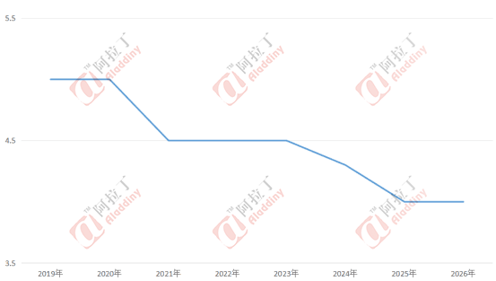


4
Significant decline in ore grade
Figure 6: Trend of the Feed Grade (Al/Si Ratio) of Local Bauxite Ore in Shanxi
In recent years, the global grade of bauxite ore has declined significantly. The ore grade in China's major bauxite-producing regions has deteriorated severely. Taking Shanxi as an example, in 2019, the aluminum-to-silicon ratio of the mill feed could reach about 5. By 2026, the ratio is expected to drop to as low as 4, greatly increasing ore processing costs. The ore consumption rate has risen from 2.2 to 2.55.

Slide 16
4
Significant decline in ore grade
Table 3: Non-Coal Mine Policies in Shanxi
Top-Level Framework | Further Strengthening Mine Work Safety Measures | Provincial Government, June 2024 | Non-coal mine rectification: "three batches" | One batch to be closed and eliminated, one batch to be integrated and reorganized, and one batch to be upgraded and improved.
 | 2026 Work Safety Notice | Jin Zheng Fa [2026] No. 1, Jan 2026 (Issued by the People's Government of Shanxi Province) | Annual deployment of key tasks for non-coal mine rectification | Smart mines, hazard surveys, full online monitoring
Quantity & Scale | Reduce quantity, improve quality of non-coal mines | Provincial deployment, 2024 | Reduction of underground mines, increase in the proportion of large and medium-sized mines | By the end of 2024: underground mines ↓≥20% from 2022; large/medium share ↑≥15%
 | Minimum construction scale threshold | Provincial Department of Natural Resources, Feb 2024 | Strict control over small mines — no approval for small-scale new construction or expansion/renovation. | Bauxite mines <300kt/year not approved
Integration | Integration standards for non-coal mines | Provincial requirement | Mines with multiple operators on the same ore body, insufficient safety distance, or substandard scale must be integrated. | Achieve "five unifications": rights, planning, operator, system, management; unified mine, permit, and system

Slide 17
4
Significant decline in ore grade
Table 3: Non-Coal Mine Policies in Shanxi
Closure | Closure & elimination standards | Departments of Provincial Emergency Management & Natural Resources | Directly close mines without permits, boundary violations, failed rectification, or depleted | Unlicensed mining, still non-compliant after suspension and rectification, refusal to rectify eliminated processes → legally closed
Safety Approval | Safety facility approval management | Jin Ying Ji Fa [2023] No. 200, etc. (Issued by Shanxi Provincial Department of Emergency Management) | High-risk mines → provincial approval; strict control on construction projects | Underground mines, high-slope open pits, and tailings ponds → provincial approval; capital construction projects limited to once, no more than 1 year
Tailings Ponds | Tailings pond rectification policies | Provincial mine safety measures | Tailings ponds only decrease, not increase; strict control over new construction; mandatory closure within time limit | No new "overhead ponds"; no new/expansion within 3km of Yellow River main stream / 1km of tributary; ponds idle >3 years → closed & deregistered
2026 Priorities | 2026 key tasks for non-coal mines | Jin Zheng Fa [2026] No. 1 | Intelligent construction, hidden hazards, online monitoring, tailings pond closure | Full online monitoring for active underground mines; close & deregister tailings ponds overdue or idle >3 years

Slide 18
4
The surge in mining rights transactions driven by rising mineral prices and the implementation of the new mining law.
Table 4: Major Bauxite Mining Rights Transactions in Shanxi Since 2024
Based on bauxite mining rights transaction data in Shanxi since 2024, the total transaction prices for mining and exploration rights range from RMB 1.039 billion to RMB 5.41 billion. The exploration right for the Nanyang Block Bauxite Mine in Xiaoyi City tops the list at RMB 5.41 billion, directly reflecting the market's strong recognition of the value of high-quality exploration blocks. This trend is closely tied to the overall prosperity of the bauxite market over the past two years.
No. | Mine Name | Type of Mining Rights | Transacti-on Date | Winning Bidder | Mineral Reserves | Starting Bid Price (RMB) | Total Transaction Price (100 million) | Equivalent Price per Ton (RMB/ton) | Concession Period (years)
1 | Xiazhaolin Block Bauxite Mine, Zhongyang County | Mining Rights | 2024/10/1 | Ningbo Kunye Trading Co., Ltd. | Bauxite: 18.34 Mt (Grade: Al₂O₃ 64.93%); Hard clay rock: 28.214 Mt; Shanxi-type iron ore: 6.73 Mt; Gallium metal: 1,357.6 tons | 1.7 million | 45 | 245 | 20
2 | Xuanfengwo Block Bauxite Mine, Qinyuan County | Mining Rights | 2025/5/15 | Shanxi Yueyanchun Mineral Products Co., Ltd. | Bauxite: 7.2346 Mt, Hard clay rock: 0.7407 Mt | 1.3 million | 10.39 | 144 | 20
3 | Zhengyi Block Bauxite Mine, Qinyuan County | Exploration Right | 2025/5/14 | Yangpu Aofeiya International Trading Co., Ltd. | Exploration area: 9.7227 km² (general survey stage). Minerals: bauxite and its associated minerals. Coal resources within the block: approximately 764,000 tons. | 1 million | 16.12 | / | 5
4 | Huazhai Block Bauxite Mine, Jiaokou County | Mining Rights | 2025/5/7 | Shanxi China Century Energy Holdings Inc. | Bauxite: 11.3152 Mt (Al₂O₃: 41.08%-78.74%) | Hard clay rock: 4.0511 Mt | Shanxi-type iron ore: 4.4231 Mt | Metal gallium: 814.69 t | / | 30.5 | 270 | 20
References: Department of Natural Resources of Shanxi Province

Slide 19
4
The surge in mining rights transactions driven by rising mineral prices and the implementation of the new mining law.
Table 4: Major Bauxite Mining Rights Transactions in Shanxi Since 2024
Based on bauxite mining rights transaction data in Shanxi since 2024, the total transaction prices for mining and exploration rights range from RMB 1.039 billion to RMB 5.41 billion. The exploration right for the Nanyang Block Bauxite Mine in Xiaoyi City tops the list at RMB 5.41 billion, directly reflecting the market's strong recognition of the value of high-quality exploration blocks. This trend is closely tied to the overall prosperity of the bauxite market over the past two years.
No. | Mine Name | Type of Mining Rights | Transaction Date | Winning Bidder | Mineral Reserves | Starting Bid Price (RMB) | Total Transaction Price (100 million) | Equivalent Price per Ton (RMB/ton) | Concession Period (years)
5 | Xitianhe Block Bauxite Mine, Wutai County | Exploration Right | 2025/5/24 | Nangou Mining Co., Ltd., Wutai County | Exploration area: 6.4189km² (general survey stage) | 1 million | 22.12 | / | 5
6 | Lijiashan Block Bauxite Mine, Jiaokou County | Exploration Right | 2025/6/23 | Shanxi China Century Energy Holdings Inc. | Exploration area: 8.7 km² (detailed survey stage) | / | 36.65 | / | 5
7 | Nanyang Block Bauxite Mine, Xiaoyi | Exploration Right | 2025/8/7 | Shanghai Ruiyelian Industrial Co.,Ltd. | Exploration area: 4.7222 km² (detailed survey stage) | 1 million | 54.1 | / | 5
8 | Yangmaping Block Bauxite Mine, Fenxi County | Exploration Right | 2025/9/8 | Shanxi Dongtai Holding Group Co., Ltd. | Exploration area: 19.1499 km² | 1.9 million | 15.299 |  | 5
9 | Guangdaoling Block Bauxite Mine, Fenxi County | Exploration Right | 2025/9/9 | Yicheng Feixiang Pipe Co.,Ltd. | Exploration area: 10.836 km² | 1 million | 32.22 |  | 5
10 | Fengjiagang Block Bauxite Mine, Jiaokou County | Exploration Right | 2025/9/10 | Jiaokou Wangzhuang Pig Iron Co., Ltd. | Exploration area: 8.198 km² | 0.8 million | 31.728 |  | 5
Total |  |  |  |  |  |  | 294.127
References: Department of Natural Resources of Shanxi Province

Slide 20
4
The surge in mining rights transactions driven by rising mineral prices and the implementation of the new mining law.
Three Bauxite Exploration Rights in Shanxi All Failed to Sell: High Thresholds and Market Downturn
Three bauxite exploration rights put up for public listing in Shanxi Province in 2026 have all failed to sell. Details are as follows: Nanping Block in Qinyuan County: Area of 19.18 km², starting price of 2.1 million yuan, bidding deposit of 50 million yuan. Failed to sell on January 21. Liujiazhuang Block in Lin County: Area of 3.84 km², starting price of 420,000 yuan, bidding deposit of 50 million yuan. Failed to sell on January 26. Majiazhuang Block in Xiangyuan County: Area of 8.56 km², starting price of 1.8 million yuan, bidding deposit of 300 million yuan. Failed to sell on March 11.
All three mining rights in this offering have significantly raised the bidding thresholds. The bidding deposit for the Majiazhuang Block in Xiangyuan County is as high as 300 million yuan. This stands in stark contrast to the booming market in 2025, when multiple bauxite mining rights in Shanxi were transacted with high premiums.
The reasons for the failed sales are multifaceted. First, the global bauxite market has entered a downturn. Second, factors such as high bidding thresholds, the high risks associated with exploration rights investments, and constraints on mining site conditions have collectively contributed to the lackluster interest in these offerings.
Yet, since 2026, the bauxite market downturn and an oversupply of imported ore have eroded the value of domestic mines. Together with bidders’skepticism over resource quality, this has led to several failed auctions this year — further proving that the domestic mining rights market is closely tied to the broader bauxite market.

Slide 21
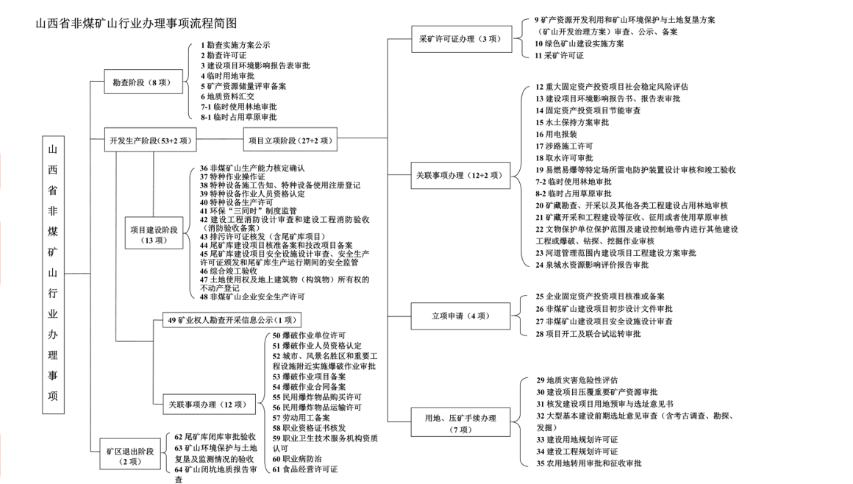
4
Complex construction procedures and long production lead times
Figure: Simplified flowchart of procedures for the non-coal mining industry in Shanxi
Shanxi Province Non-Coal Mining Industry Procedure Flowchart
9. Mineral Resource Development and Utilization & Mine Environmental Protection and Land Reclamation Plan
10. Green Mine Construction Implementation Plan
11. Mining License
1. Exploration Implementation Plan Publication
2. Exploration License
3. Construction Project Environmental Impact Report Form Approval
4. Temporary Land Use Approval
5. Mineral Resource Reserve Review and Filing
6. Geological Data Submission
7-1. Temporary Forest Land Use Approval
8. Temporary Grassland Occupancy Approval
Mining License Application (3 items)
Exploration Stage
(8 items)
12. Major Fixed Asset Investment Project Social Stability Risk Assessment
13. Construction Project Environmental Impact Report / Report Form Approval
14. Fixed Asset Investment Project Energy Conservation Review
15. Soil and Water Conservation Plan Approval
16. Electricity Connection Application
17. Road-Related Construction Permit
18. Water Extraction Permit Approval
19. Lightning Protection System Design Review and Completion Acceptance for Flammable/Explosive Specific Locations
7-2. Temporary Forest Land Use Approval
8-2. Temporary Grassland Occupancy Approval
20. Forest Land Occupancy Review for Mineral Exploration/Extraction and Other Engineering Construction
21. Grassland Review for Expropriation, Requisition, or Use due to Mineral Extraction and Engineering Construction
22. Approval for Other Construction Engineering, Blasting, Drilling, or Excavation Operations within Protection Scope and Construction Control Zones of Cultural Relics Protection Units
23. Construction Plan Approval for Projects within River Course Management Scope
24. Spring Catchment Area Water Resources Impact Assessment Report Approval
Development & Production Stage (53+2 items)
Project Establishment Stage (27+2 items)
(Shanxi Province Non-Coal Mining Industry Administ-rative Matter)
36. Non-Coal Mine Production Capacity Verification and Confirmation
37. Special Operation Certificate
38. Special Equipment Construction Notification & Special Equipment Use Registration
39. Special Equipment Operator Qualification Certification
40. Special Equipment Production Permit
41. "Three Simultaneities" System Supervision for Environmental Protection
42. Construction Engineering Fire Protection Design Review & Fire Protection Completion Acceptance (Fire Protection Acceptance Recordation)
43. Pollutant Discharge Permit Issuance (including Tailings Pond Projects)
44. Tailings Pond Construction Project Approval/Record and Technical Renovation Project Record
45. Tailings Pond Construction Project Safety Facility Design Review, Safety Production License Issuance, and Safety Supervision during Operation
46. Comprehensive Completion Acceptance
47. Real Estate Registration of Land Use Rights and Ownership of Above-Ground Buildings (Structures)
48. Non-Coal Mining Enterprise Safety Production Permit
Related Matter Handling (12+2 items)
Project Construction Stage (13 items)
25. Enterprise Fixed Asset Investment Project Approval or Record
26. Non-Coal Mine Construction Project Preliminary Design Document Approval
27. Non-Coal Mine Construction Project Safety Facility Design Review
28. Project Commencement & Joint Trial Operation Approval
49. Mining Rights Holder Exploration and Mining Information Disclosure
Project Establishment Application (4 items)
50. Blasting Unit Permit
51. Blasting Personnel Qualification Certification
52. Blasting Operation Approval near Cities, Scenic Spots, and Important Engineering Facilities
53. Blasting Operation Project Record
54. Blasting Operation Contract Record
55. Civil Explosive Materials Purchase Permit
56. Civil Explosive Materials Transport Permit
57. Labor Employment Record
58. Professional Qualification Certificate Issuance
59. Occupational Health Service Institution Qualification
60. Occupation Disease Prevention
61. Food Operation Permit
29. Geological Hazard Risk Assessment
30. Construction Project Approval for Mineral Resources Overlain
31. Pre-approval of Construction Land Use and Site Selection Opinion Letter Issuance
32. Large-Scale Capital Construction Preliminary Site Selection Opinion Review (including Archaeological Survey/Exploration/Excavation)
33. Construction Land Use Planning Permit
34. Construction Engineering Planning Permit
35. Agricultural Land Conversion Approval and Expropriation Approval
Related Matter Handling (12+2 items)
Land Use & Mineral Pressure Handling (7 items)
62. Tailings Pond Closure Approval and Acceptance
63. Mine Environmental Protection & Land Reclamation and Monitoring Status Acceptance
64. Mine Closure Geological Report Review

Slide 22
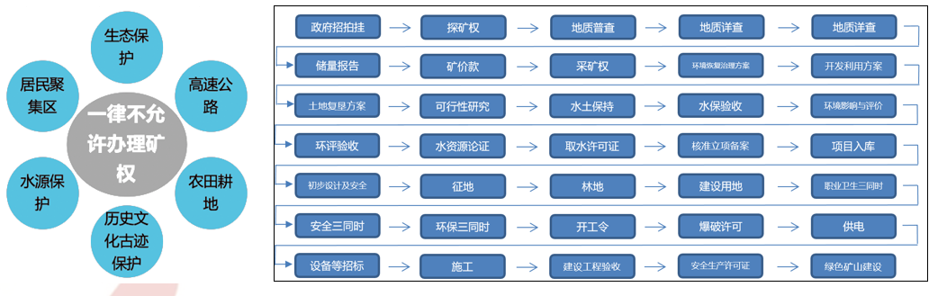
4
Complex construction procedures and long production lead times
For a new mine, the entire cycle from obtaining an exploration license to acquiring a mining license, and then to completing construction and commencing extraction, takes approximately 3 to 5 years.
Ecological protection
Government auction
Exploration right
Geological General Survey
Geological Detailed Survey
Geological Detailed Survey
Reserve Report
Mining Right Price
Mining Right
Environmental Restoration and Governance Plan
Development and Utilization Plan
Ecological protection
Expressway
The granting of mining rights is strictly prohibited.
Land Reclamation Plan
Feasibility Study
Soil and Water Conservation
Soil and Water Conservation Acceptance
Environmental Impact Assessment
EIA Acceptance
Water Resources Demonstration
Water Extraction Permit
Approve, Project Establishment and Record
Project Entry into Database
Water source protection
Farmland and cultivated land
Preliminary Design and Safety
Land Expropriation
Forest Land
Construction Land
Occupational Health "Three Simultaneities"
Protection of historical and cultural relics
Safety "Three Simultaneities"
Environmental Protection "Three Simultaneities"
Commencement Order
Blasting Permit
Power Supply
Equipment and Other Tendering
Construction
Construction Project Acceptance
Safety Production License
Green Mine Construction

Slide 23
4
Complex construction procedures and long production lead times
In summary, the supply-demand dynamics of bauxite and alumina in Shanxi are the core variables shaping the marginal structure of China's bauxite-alumina market. As the country's largest and most representative inland alumina-producing region, Shanxi plays an irreplaceable role in domestic ore security, regional demand matching, and capacity flexibility. Its production rhythm, raw material composition, and cost changes directly affect the national alumina market's balance and price trends. With a current industry pattern of "coastal reliance on imports, inland reliance on domestic ore," Shanxi leverages its local resource advantages, ongoing technical upgrades, and raw material blending optimization to demonstrate strong resilience and adaptability. Alumina enterprises with stable local ore sources have more prominent cost control and risk resistance advantages.
Meanwhile, the inherent disadvantages of Shanxi's inland location — long distances and high logistics costs for imported ore — remain prominent and serve as a key bottleneck constraining industry efficiency gains. While enterprises continue to optimize logistics and raw material structures through railway rate reductions, multimodal transport, and ore blending, the long-term solution requires coordinated efforts in port collaboration, transport corridor development, and capacity planning to systematically lower the comprehensive cost of importing ore into Shanxi. This will further strengthen the competitive edge of the inland alumina industry and support the stable, efficient operation of the national aluminum industry chain and supply chain.

Slide 24
Thanks for Listening
Speaker：Liu Dan
Date: 2026.5

