Slide 1
几内亚铝土矿驳运现状及前景分析
The Situation and Prospect of Bauxite Transshipment in Guinea
万邦（中国）船务有限公司
IMC Shipping（China) Co. Ltd
赵煜弘 / Zhao Yuhong
28th May 2026

Slide 2
目
录
1.几内亚铝土矿生产出口现状及前景
1. Guinea Bauxite Production/Export Situation and Prospects
2.几内亚铝土矿驳运现状及前景
2.Guinea Bauxite Transshipment Situation and Prospects
3. Introduction of IMC’s Transshipment Business
3.万邦集团驳运业务简介

Slide 3
1.几内亚铝土矿生产出口现状及前景
1.Guinea Bauxite Production/Export
Current Situation and Prospects

Slide 4
2025年铝土矿储量和产量，几内亚都独占鳌头
In 2025, Guinea holds the leading position in bauxite reserves and production
根据《世界矿产品摘要2026》数据：2025年全球铝土矿储量为290亿吨。储量排名前5位的国家依次为几内亚（74亿吨、25.52%）、澳大利亚（37亿吨、12.76%）、越南（31亿吨、10.69%）、印尼（29亿吨、10%）、牙买加（20亿吨、6.90%）。前五国家占比为66.08%，铝土矿储量集中度较高。
2025年产量排名前5位的国家依次为几内亚、澳大利亚、中国、巴西、印度。几内亚稳居全球第一

Slide 5
几内亚铝土矿产量
Guinea Bauxite Production（2015-2025）
Year | 2015 | 2016 | 2017 | 2018 | 2019 | 2020 | 2021 | 2022 | 2023 | 2024 | 2025
World Production（mtpa） | 270 | 280 | 300 | 328 | 355 | 359 | 368 | 383 | 400 | 450 | 532
Guinea Production（mtpa） | 21 | 32 | 52 | 60 | 70 | 88 | 86 | 102 | 127 | 146 | 183
Export to China from Guinea（mtpa） | 0.3 | 12 | 28 | 38 | 44 | 53 | 55 | 70 | 99 | 110 | 149.5
2025年，几内亚铝土矿年产量约1.83亿吨，74%运往中国，稳居全球最大铝土矿生产和出口国。
In 2025, Guinea's annual bauxite production was approximately 183 million tons, with 74% shipped to China, solidifying its position as the world's largest producer and exporter of bauxite.

Slide 6
铝土矿供应端前景（几内亚）
Bauxite Supply Prospect (Guinea)
政府矿业政策的调整或影响出口量 – 限产；
Adjustments to government mining policies may affect export volumes--production restrictions;
铝土矿本土深加工产业化的推进；
Advancement of domestic deep-processing industrialization for bauxite;
3. 新的采矿许可证的审批更加艰难，时间更长；
Stricter and longer approval processes for new mining licenses;
4. 成立国家航运公司，对港口、码头、河道运输更多制约；
Establishment of a national shipping company imposing stricter regulations on ports, docks, and river transport;
5. 河道水运趋向饱和；
River transport is approaching saturation;
6. 价格因素（海运）。
Pricing factors (Shipping).

Slide 7
铝土矿需求端前景（中国）
Bauxite Demand Prospect (China)
2025年铝土矿总产量（进口+本土）2.874亿吨，进口2.012亿吨，进口占总量的70%，其中几内亚1.5亿吨，占74%；
In 2025, total bauxite production (imported + domestic) reached 287.4 million tons, with imports accounting for 201.2 million tons (70% of the total), including 150 million tons from Guinea (74%).
电解铝产能的天花板;
The ceiling for electrolytic aluminum production capacity remains ;
氧化铝的产能及开工率，2026年预计达到1.2亿吨，开工可能小于1亿吨；
Alumina production capacity and utilization rate are projected to reach 120 million tons in 2026, though actual operation may fall below 100 million tons.
地缘冲突，国际贸易的不确定性（美税反复无常）等等带来供应链稳定性下降；
Geopolitical conflicts and uncertainties in international trade (particularly volatile U.S. tariffs) have undermined supply chain stability;
价格因素。
Compounded by price factors.

Slide 8
2. 几内亚铝土矿驳运现状及前景
2. Situation and Prospects
Of Guinea Bauxite Transshipment

Slide 9
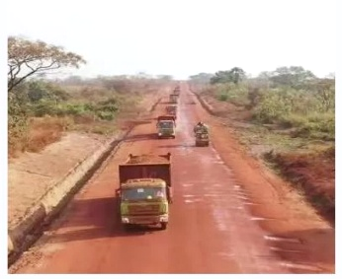
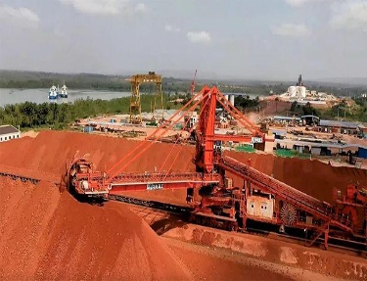
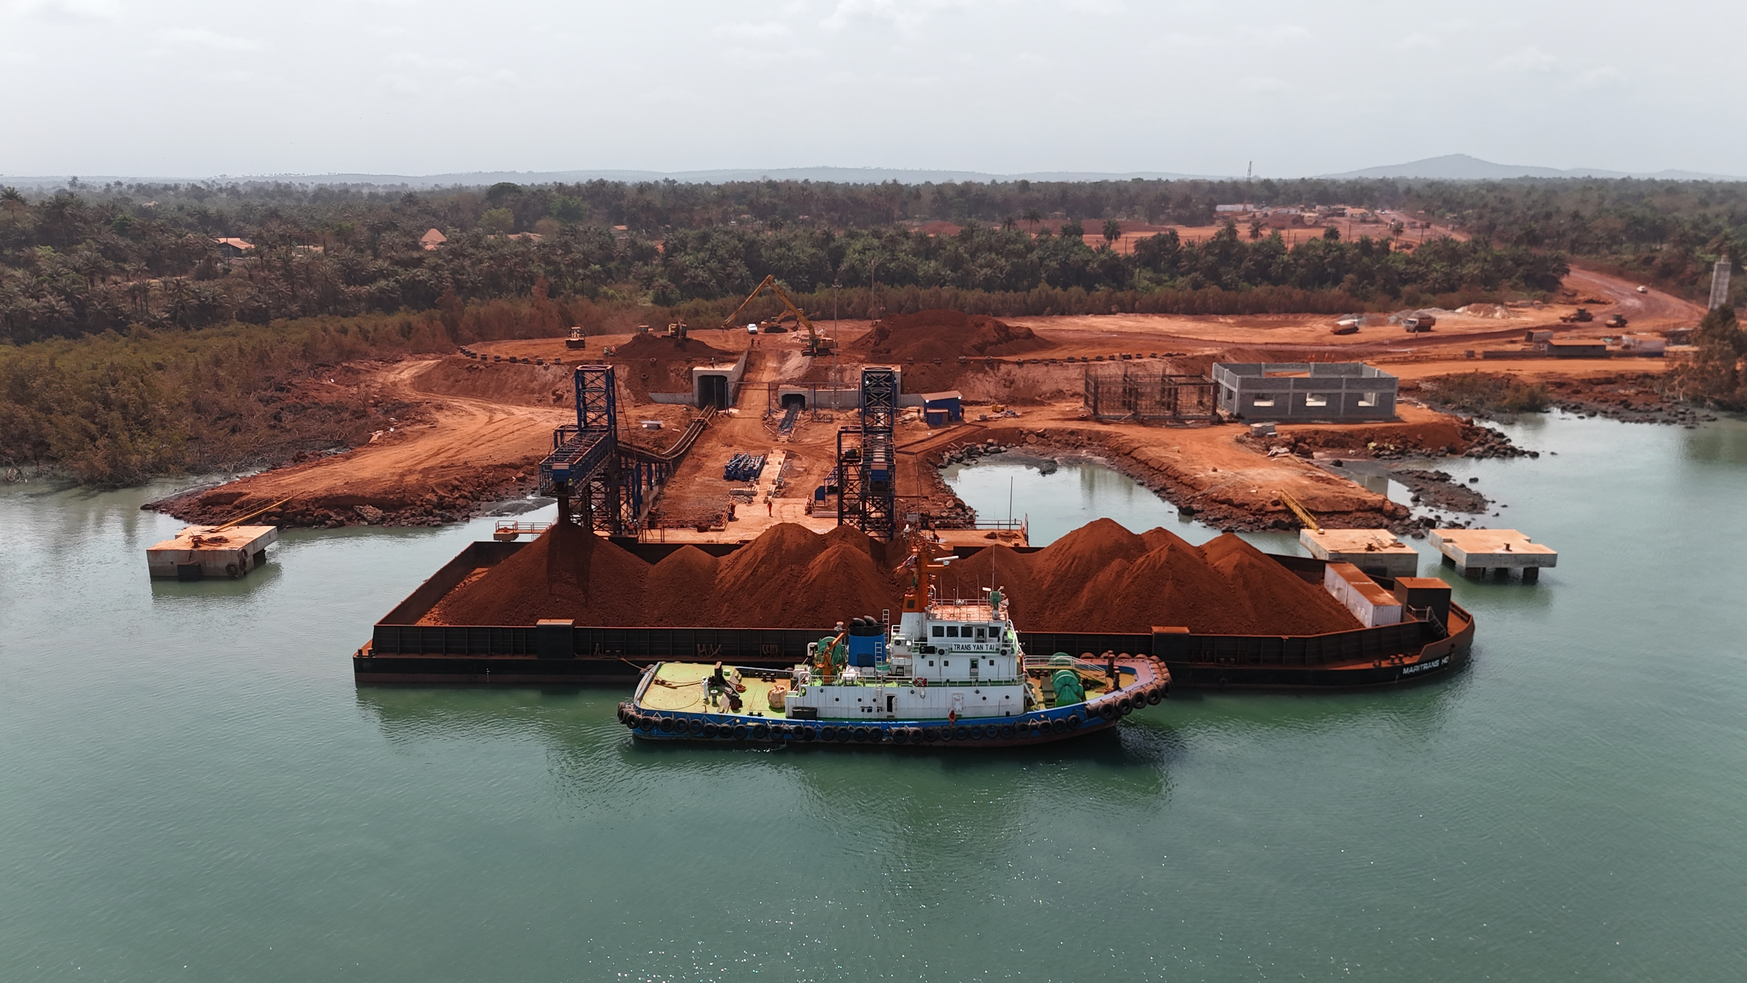
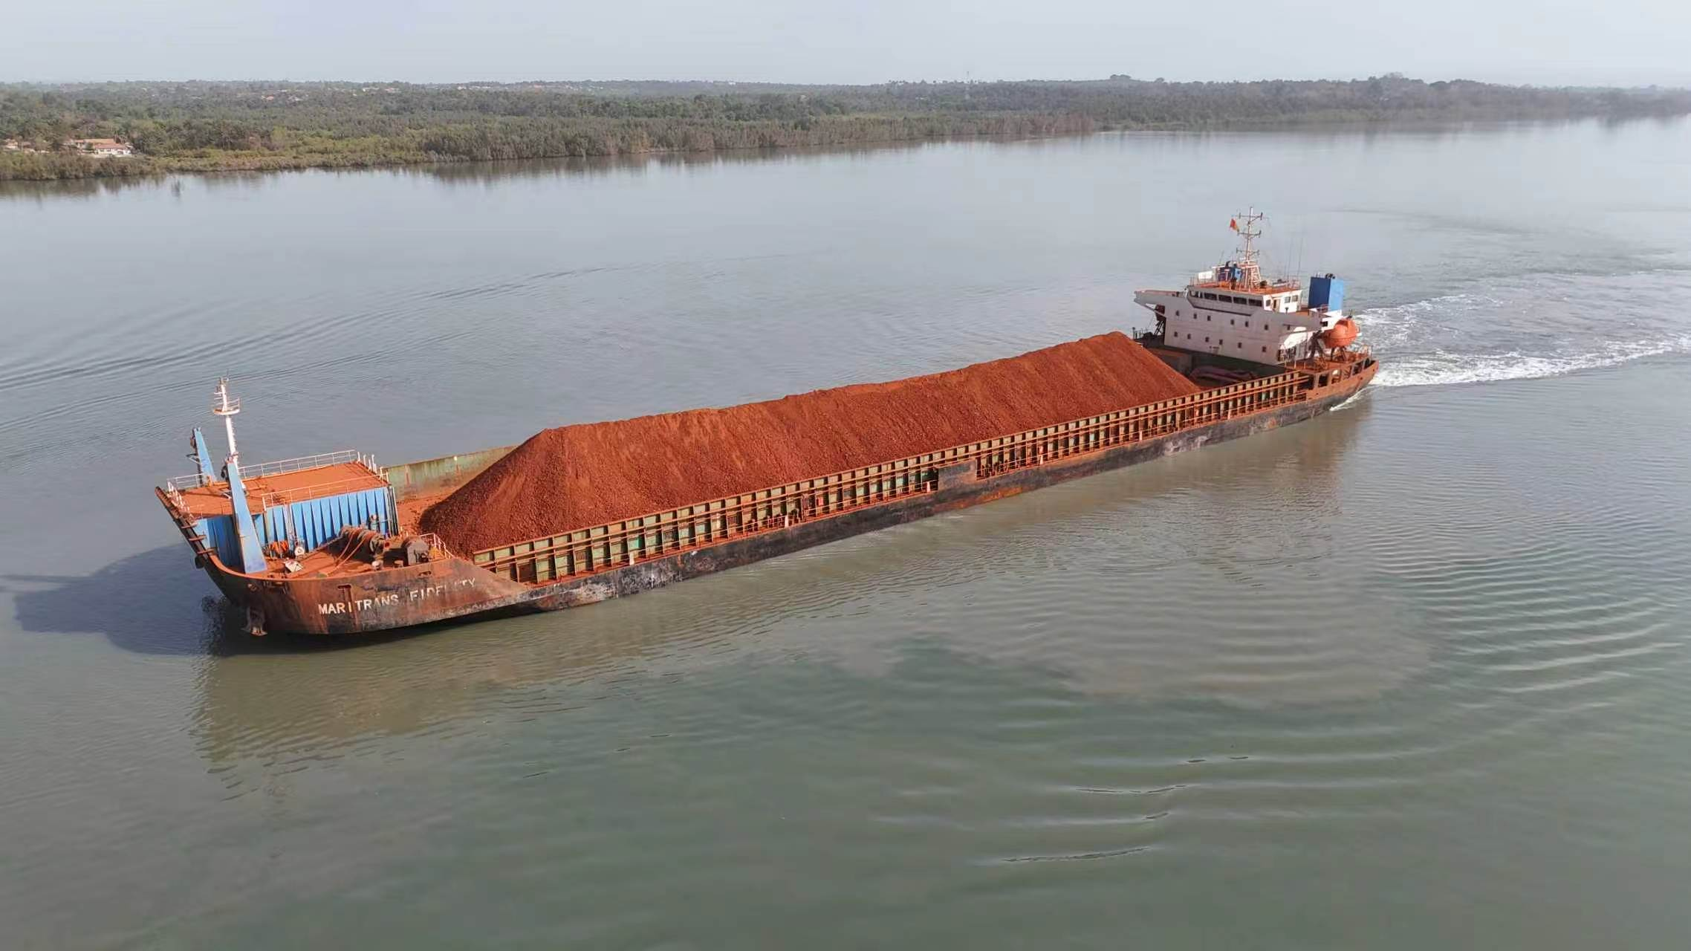
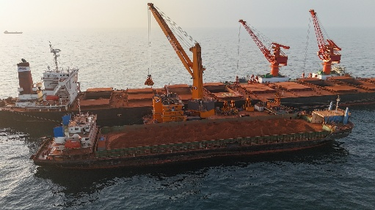
几内亚铝土矿运输方式
矿山
陆上运输
码头堆场
码头装船
水上过驳
远洋运输
目的港
内河运输

Slide 10
几内亚铝土矿采用驳运不是可选项， 而是”刚需”
Guinea Bauxite Transportation is not an optional matter, but a necessity
几内亚沿海多为滩涂，没有深水港，建造20万吨至30万吨大型码头基本不可能，大型OGV船舶必须抛锚外海，需要靠驳船将矿石从内河码头或者沿海浅水码头转运至外海锚地提供过驳平台转驳到OGV。
The coast of Guinea is mostly composed of mudflats and there are no deep-water ports. It is practically impossible to build large berth ranging from 200,000 to 300,000 tons. Large OGV ships must anchor offshore and need to rely on barges to transfer the Bauxite from river ports or coastal shallow-water ports to the transhipper at offshore anchorages.

Slide 11
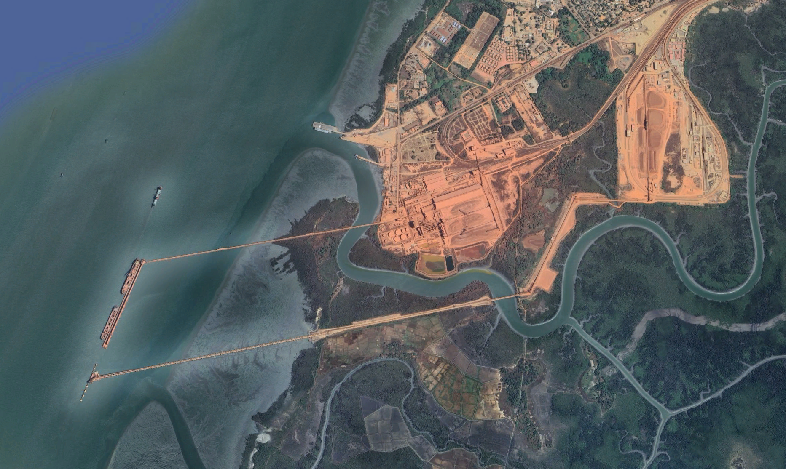
CBG Kamsar Terminal

Slide 12
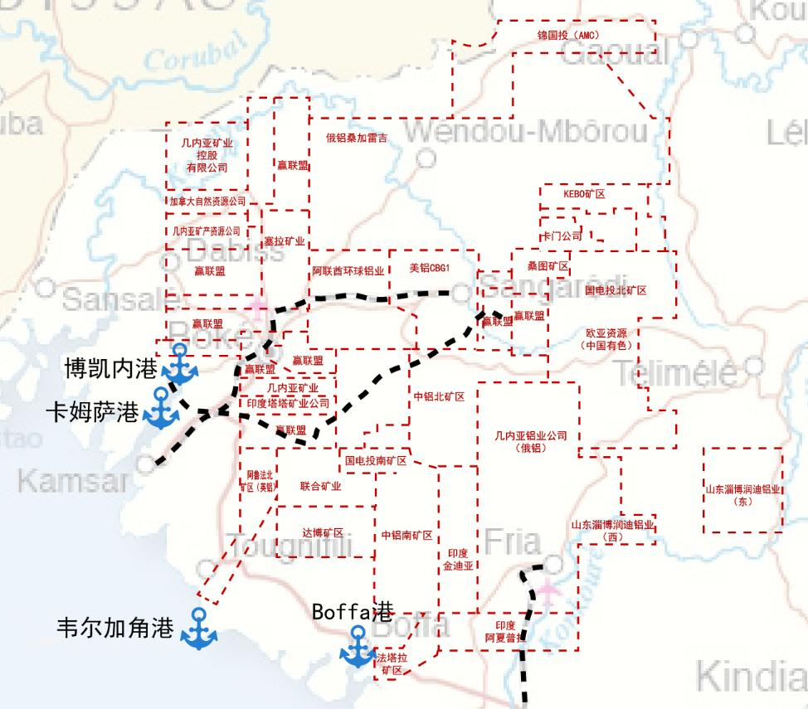
几内亚铝土矿开发现状
Status of Bauxite Development in Guinea
几内亚铝土矿矿区基本位于几内亚中西部，地理位置相对集中，普遍距离出海口较远。截至目前，几内亚主要有20个左右铝土矿开采和出口公司投产，铝土矿主要在二大内河18个码头下载。
The bauxite mining areas in Guinea are primarily located in the country's central and western regions, with a relatively concentrated geographical distribution and generally situated far from seaports. To date, there are 20 major bauxite mining and export companies operating in Guinea, with bauxite primarily unloaded at 18 terminals along two major inland rivers.

Slide 13
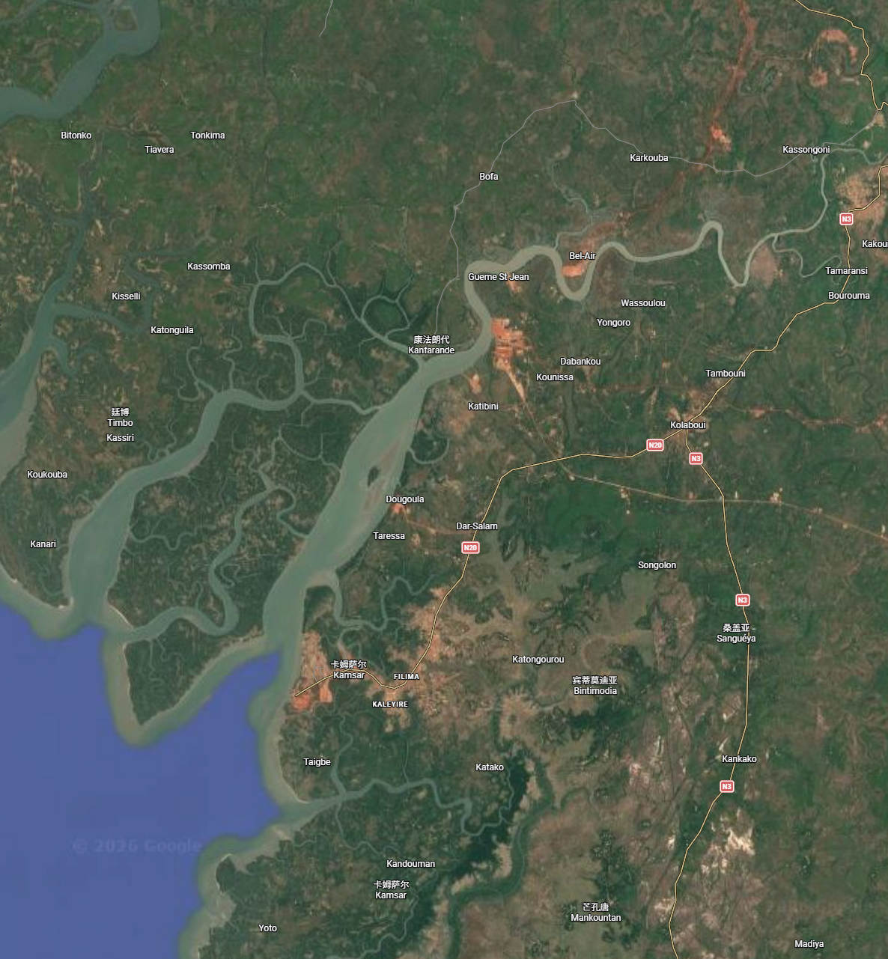
几内亚港口 Guinea Ports
奴涅兹河 Nunez River
9个码头位于卡姆萨港区：美铝CBG、宁巴Nimba（阿铝GAC）、俄铝COBAD，赢联盟二个港口、印度动力矿业DM、 河南国际CDM China、 阿夏普拉、特变电工；
The nine terminals of the Bokainai River Port are located in the Kamsa Port Area: CBG, Nimba (GAC), Rusal CBAD, two ports operated by Wining Alliance, DM (Indian Power Mining), Henan International CDM China, Ashapula and TBEA.
SMB Katougouma Port
（赢联盟1号码头）
ASHAPULA
（阿夏普拉）
GDM Port
SMB Dapilon Port
（赢联盟2号码头）
CDM-HENAN（河南国际码头）
COBAD
（俄铝）
Dyamic
（动能矿业）
CBG
（几内亚铝土矿公司）
TEBA
（特变电工）
Nimba Mining
（宁巴矿业）

Slide 14
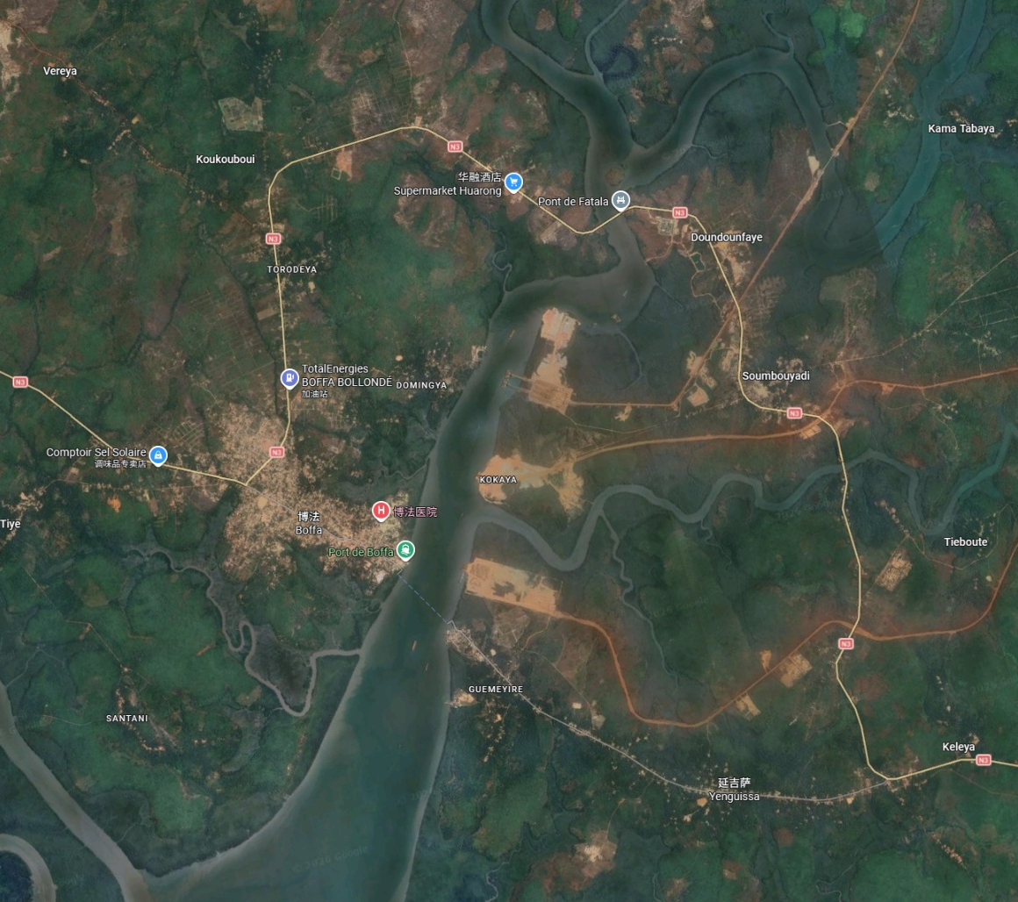
几内亚港口 Guinea Ports
Fatala River
6个在博法港：中铝、顺达、水电、 阿夏普拉、国云Rouge和金波；
Six companies are located in Bofa Port: Chalco, Shunda, Hydropower, Ashapula, Guoyun Rouge, and Jinbo.
中国铝业
皮带跨河大桥
Fatala 大桥
中国铝业
多用途码头及船台
中国铝业
Boffa营地
CHALCO (COSCO) Port
（益丰）
ROUGE
（国云）
中国铝业
铝土矿装船码头
Shunda Port
（顺达）
Sinohydro 11 Port
（中电11局）
Kimbo Port
（金波）
ASHAPULA
（阿夏普拉）

Slide 15
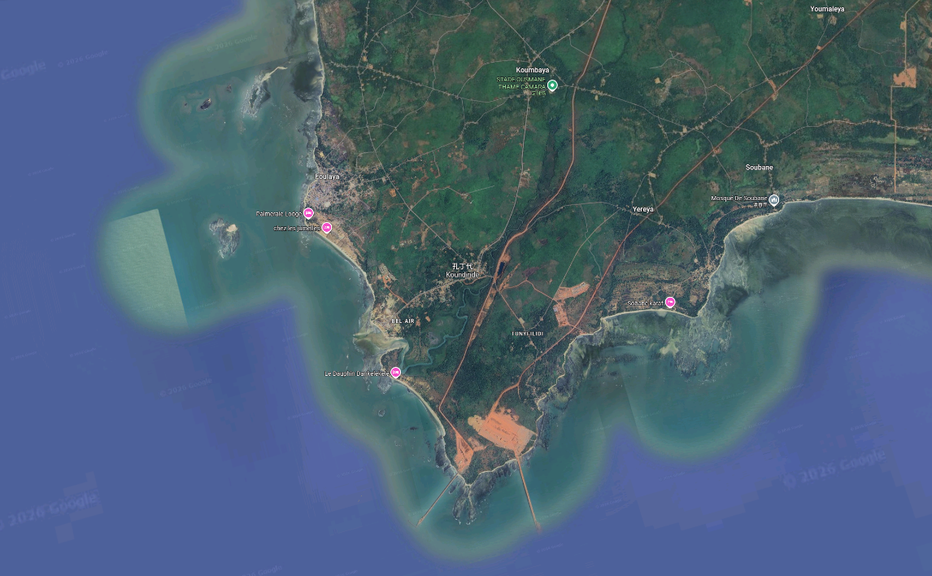
几内亚港口 Guinea Ports
2个位于维嘉角港： 阿鲁法Alufer 和国电投SPIC；
Two facilities are located in Vijaya Port: Alufer and SPIC (State Power Investment Corporation);
SPIC Port
（国电投）
Alufer Port
(Bel-Air)

Slide 16
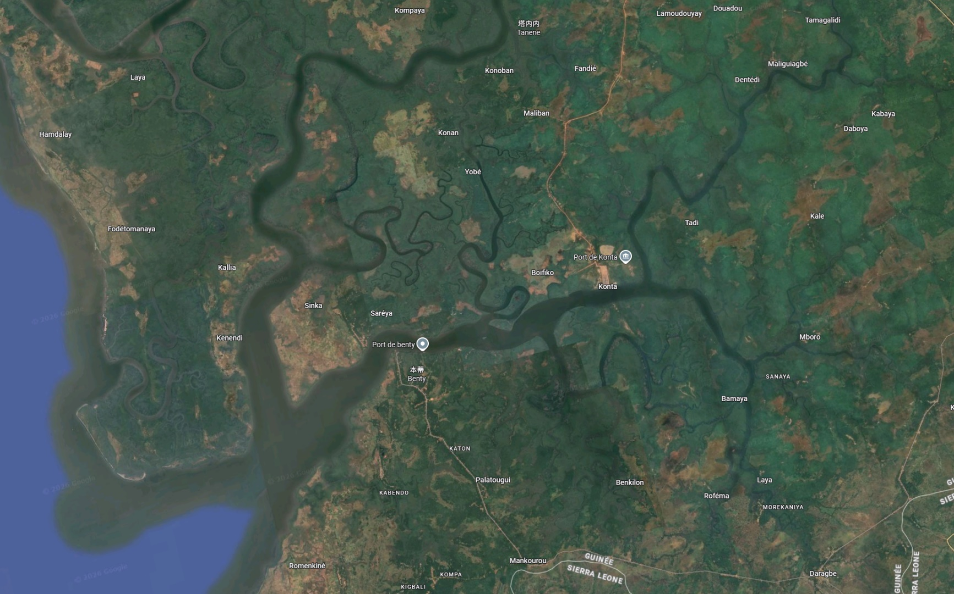
几内亚港口 Guinea Ports
Conakry & Konta River
1个位于科纳克里港：俄铝CBK；
1个位于Konta港；
另有几个项目在建设当中。
One is situated in Conakry Port: Rusal CBK; another is in Konta Port; with several additional projects currently under construction.
Konta Port

Slide 17
几内亚铝土矿企业的供应增量
The increase in bauxite supply comes from mining companies in Guinea.
日期 | 2024年 | 2025年 | 增量 | 备注
赢联盟SMB | 5505 | 7152 | 1647 | 从需求角度和其自身计划来看，仍可能有增量，
中铝几内亚CHALCO | 1445.9 | 2211.9 | 766 | 2025年飞速发展，1800-2000万吨是相对合理的
几内亚铝土矿公司CBG | 1575 | 1737 | 162 | 近三年的增量有限，维持在1700万吨左右
双铝-顺达AGB2A-SD | 1970.4 | 1701.4 | -269 | 第二个泊位已投入使用，2025受停产影响，产量不升反降，今年有望大幅上升
阿夏普拉ASHAPULA | 263.1 | 934 | 309 | 二个矿区（2025开始投产）二个码头，法塔拉河第三个码头建设中（用金波的码头）
俄铝CBK-金迪亚 | 293 | 378 | 85 | 收购文丰30%的股权后，将会有增量
俄铝COBAD-甸甸 | 470.4 | 615.4 | 145 | 充满不确定性
河南国际CDM-HENAN | 1012.4 | 940.4 | -72 | 港口建成后，产量有望增加，驳运依靠SMB
国家电投SPIC | 306.6 | 397.6 | 91 | 矿石品位较差，需要采购优质的矿石掺配，预计能够维持当前的产量和出口量
阿鲁法ALUFER | 208.7 | 174.4 | -34 | 有增加设备的计划，包括浮吊和驳船
高顶（TOP） | 203 | 132 | -71 | 用金波的码头
GIC二期 水电十一局 | 148 | 430 | 282 | 2025受停产影响很大， 今年有望大幅上升
金波矿业KIMBO |  |  |  | 有扩建码头的计划，需要关注其售矿和资金情况
特变电工 |  |  |  | 建设道路
DM动能矿业 | 35.6 | 392.6 | 222 | 码头下载量是瓶颈
NIMBA（GAC） | 1080.5 | 118.5 | -962 | 收购GAC
Zhicheng/GBT志诚矿业 | 35.6 | 392.6 | 357
ELITE艾利特 | 0 | 52.4 | 52
KBM | 0 | 270.6 | 271
GEMIC | 0 | 35.3 | 35
AMC | 0 | 679.6 | 680
ROUGE MINING |  |  |  | 码头建成后， 2026有望达到千万吨
合计 | 14553.2 | 18383.4 | 3696 | 单位：万吨、湿吨

Slide 18
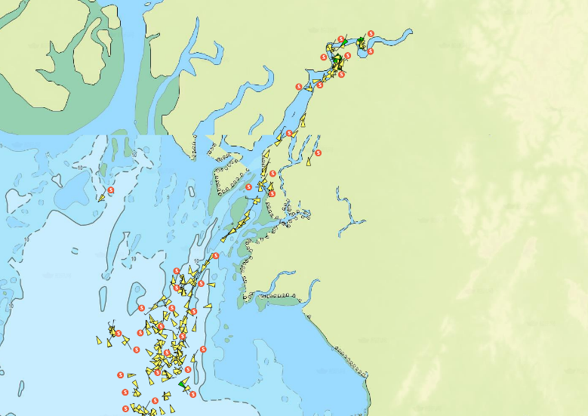
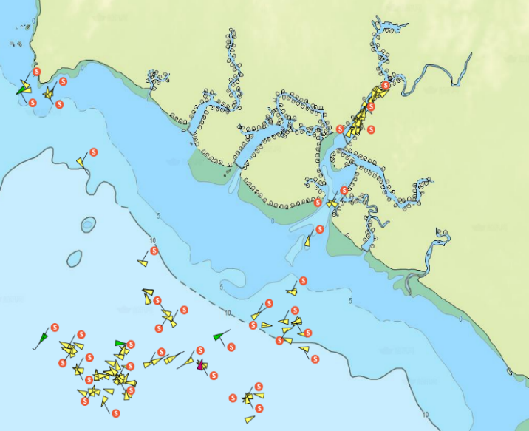
河道运输趋向饱和
River transport approaching saturation.
Rio Nunez河口目前有8家铝土矿码头在运营，根据相关研究航道通航能力约1.1~1.4亿吨/年。2025年出货量约1.2亿吨，运量接近上限。
Currently, eight bauxite terminals are operational at the Rio Nunez River. According to relevant studies, the capacity ranges from 110 to 140 mtpa. In 2024, annual shipments reached approximately 120 mtpa, approaching the maximum capacity.
Rio Nunez 河
Fatala河口自上游向下有6家矿企共用航道。根据相关研究目前航道通航能力约1.0亿吨/年，2025年出货量已超5650万吨/年，2026年将估计近9000万吨，运量接近上限。
At the Fatala River estuary, six mining companies share the navigation channel from the upper reaches downstream. According to relevant studies, the current annual navigation capacity of the channel is approximately 100 mtpa, while by 2025, the annual shipment volume has exceeded 56.5 mtpa, 2026 estimated 90mtpa, approaching the maximum capacity.
Fatala 河

Slide 19
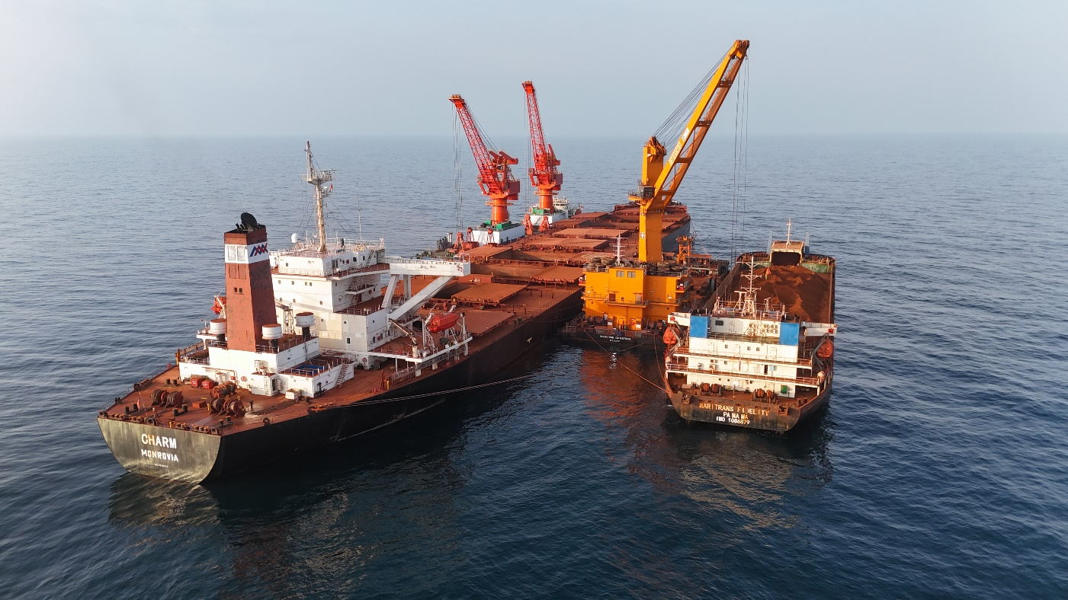
几内亚锚地过驳运力
Transshipment Capacity at Anchorage
根据我们的统计，几内亚锚地目前有约35艘浮吊（包括上个月刚刚增加的4台），4座过驳平台，2艘STV，年过驳运力为250mtpa。
According to our statistics, at Guinea anchorage currently hosts approximately 35 floating cranes (including 4 units added last month), 4 transshipment platforms, and 2 STVs, bringing the total capacity to 250 mtpa.

Slide 20
几内亚过驳运力前景
Guinea transshipment capacity prospects
根据以上驳运运力需求分析，我们估算目前的驳运能力已经趋向饱和，近期应该不会有新运力新驳运公司的加入。几内亚铝土矿出口各个环节，从技术层面上讲，驳运这一块是最难的，几内亚本地几乎没有驳运所需技术支持，如船舶维修等等。
Based on the analysis of barge capacity demand above, we estimate that current barge capacity is approaching saturation, and no new capacity or barge operators are expected to enter the market in the near term. In terms of technical challenges across the various stages of Guinea‘s bauxite export process, the transshipment is the most difficult part. There is virtually no technical support infrastructure in Guinea, such as vessel repair and maintenance services.
期望几内亚各过驳公司，紧密联系，取长补短，互助互利， 合作共赢！
We hope that all transshipment operators in Guinea can stay closely connected, learn from one another, and work together for mutual benefit and shared success!

Slide 21
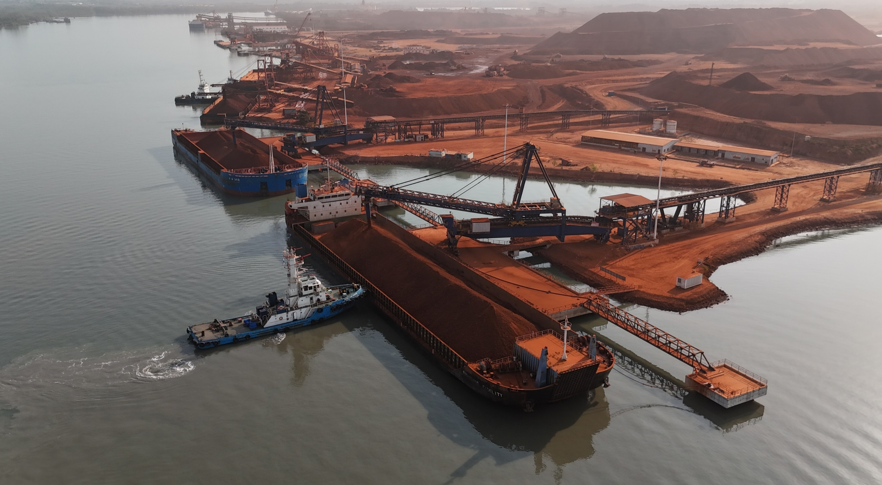

Slide 22
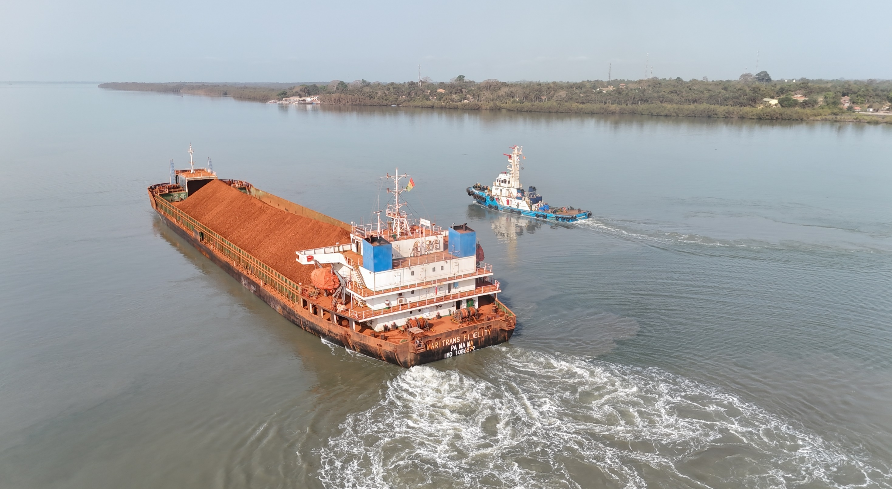

Slide 23
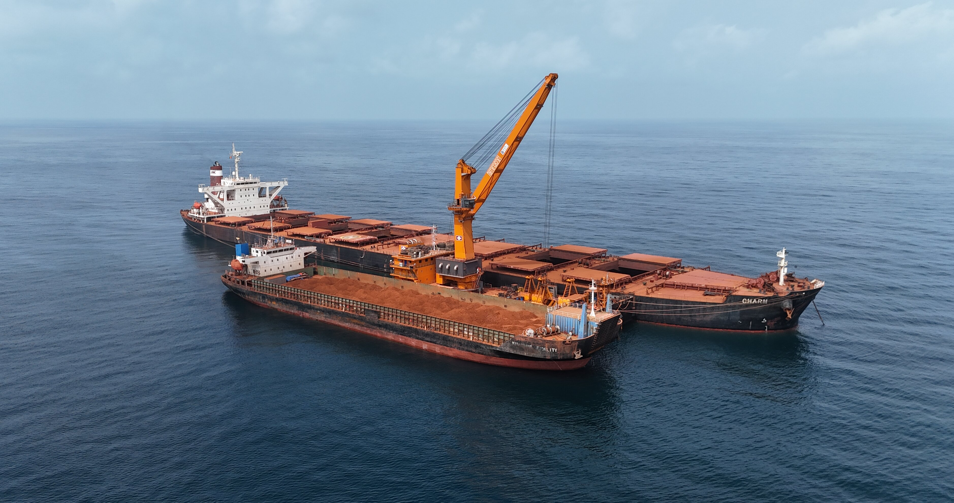

Slide 24
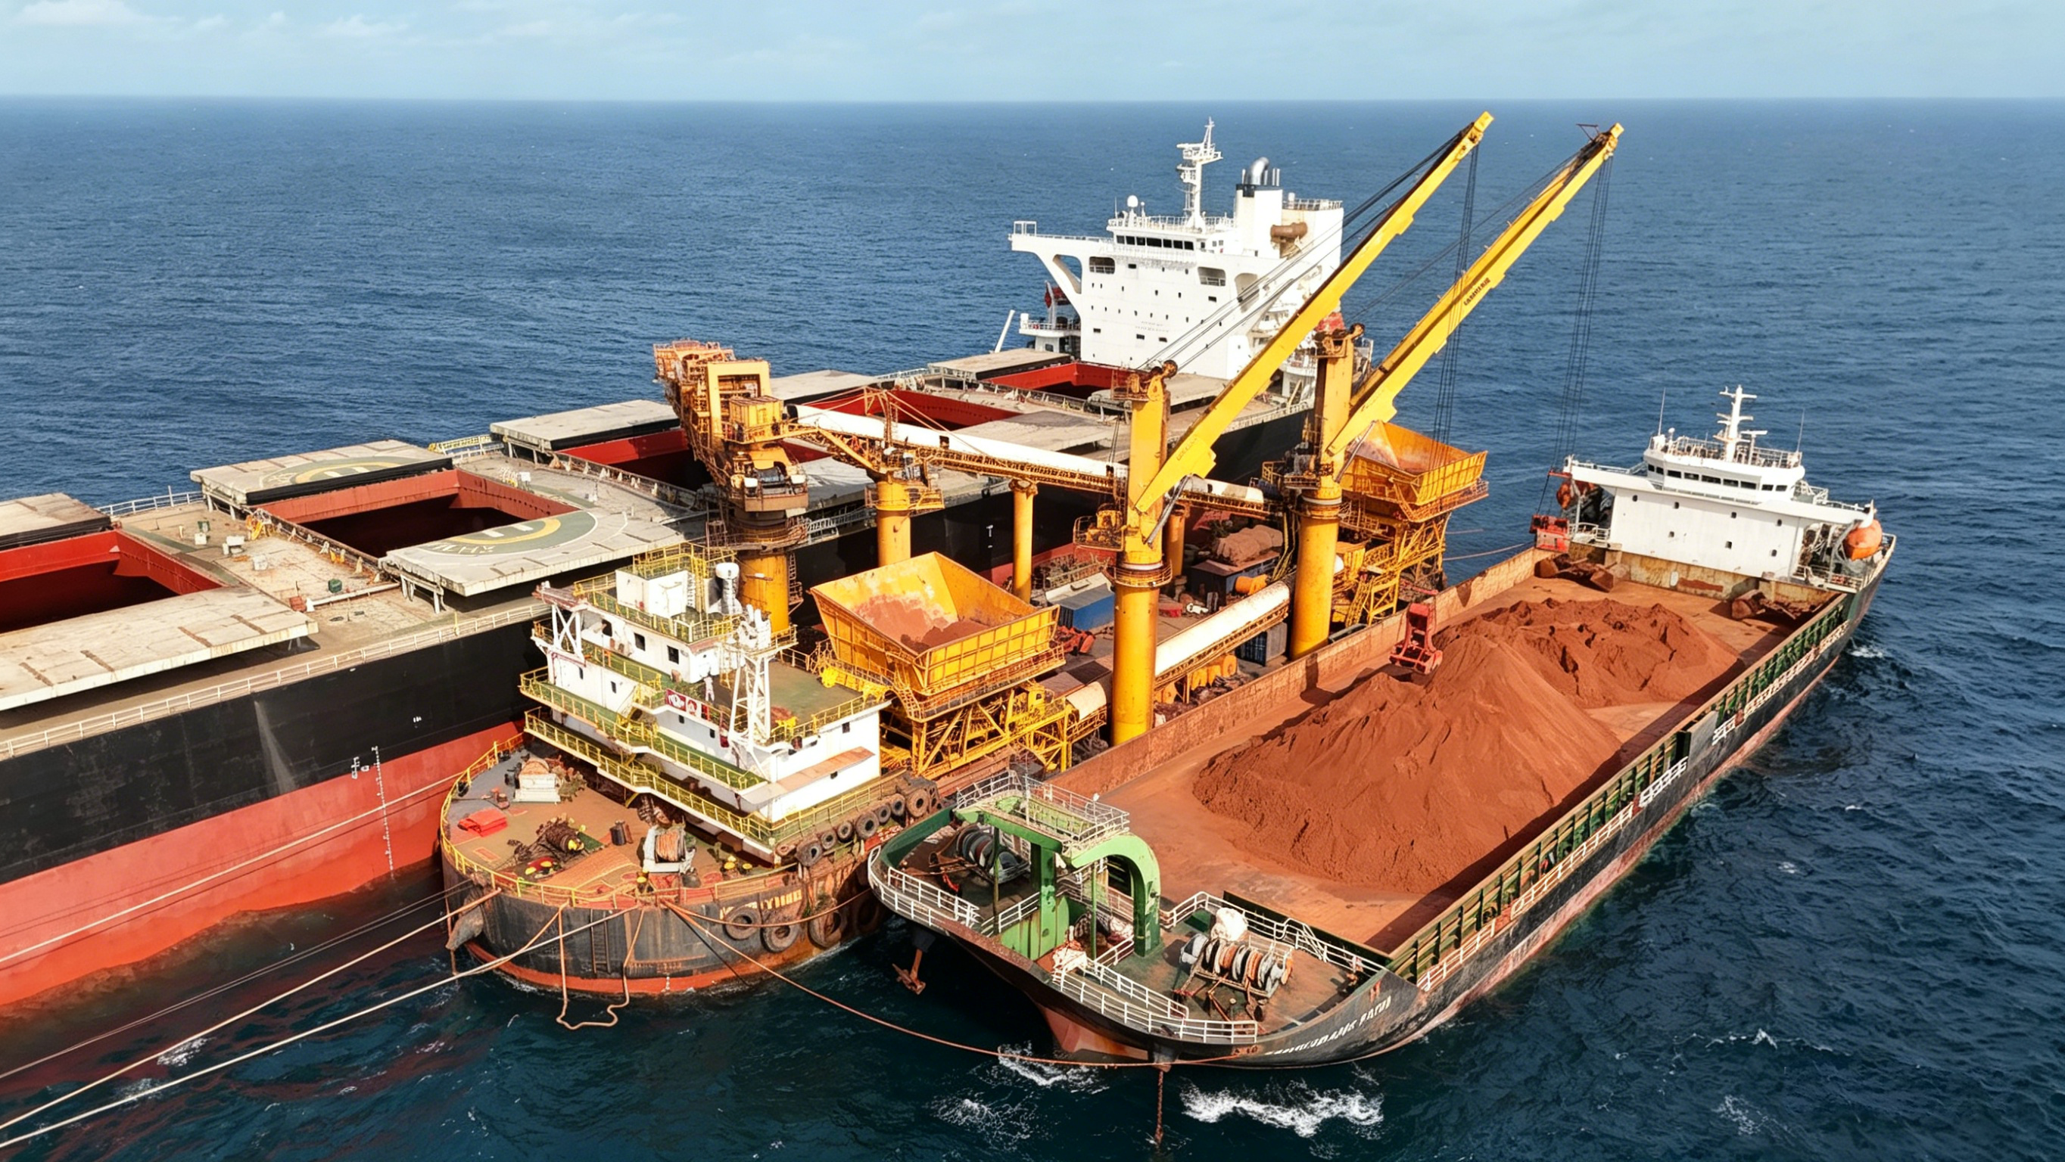

Slide 25
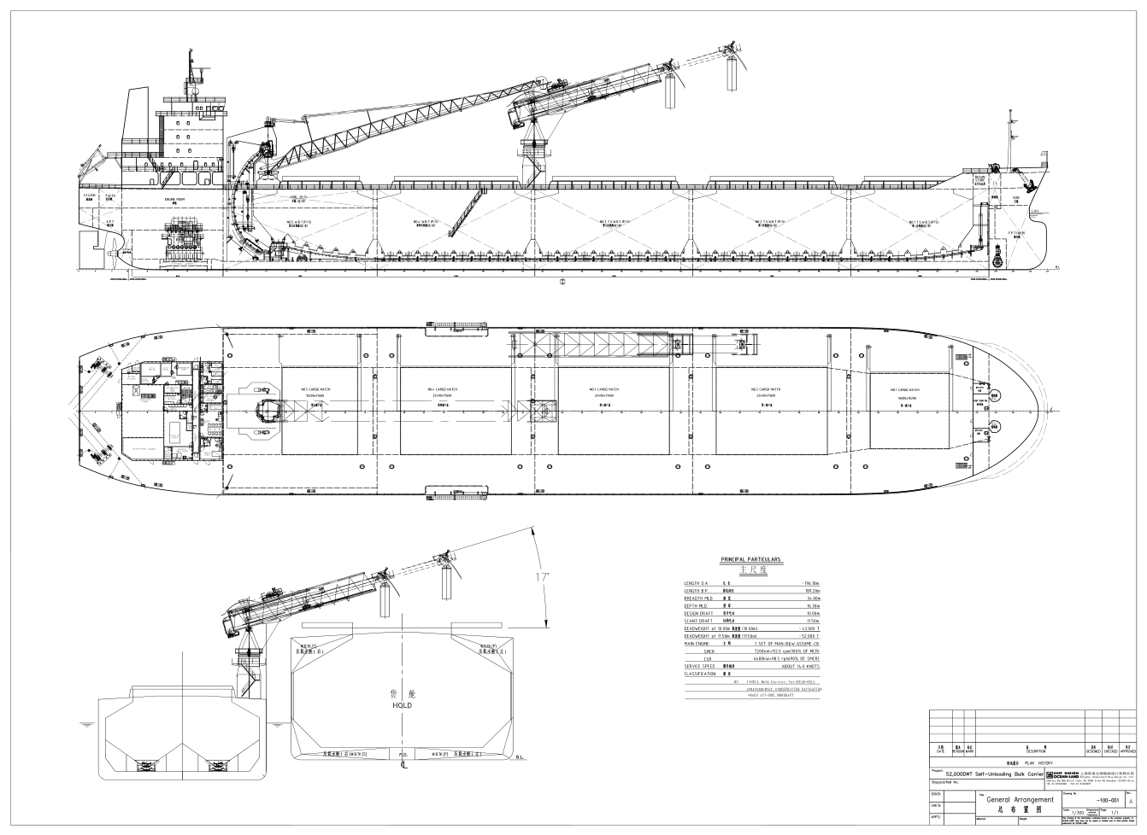

Slide 26
3.万邦集团驳运业务简介
3. Introduction of IMC’s Transshipment Business

Slide 27
万邦集团简介
Introduction to IMC
万邦航运集团公司自50年代起建立了自己庞大的散货船队，创始人曹文锦先生在上世纪七，八十年代与环球航运包玉刚、东方海外董浩云、华光航运赵从衍并称香港四大船王，曾任香港船东协会主席。 1968曹文锦先生与糖王郭鹤年先生一起组建了马来西亚国际航运公司MISC 。1986曹文锦先生组织香港十多位顶级富商建造了新加坡的国际会展中心新达城。
Since the 1950s, IMC has established an extensive fleet of bulk carriers by founder, Mr. Wen-King Tsao, who was one of Hong Kong's "Four Great Shipping Magnates" alongside Pao Yue-kong (World-Wide Shipping), Tung Chao-yung (Orient Overseas), and Chao Tsung-ien (Wah Kwong Shipping) during the 1970s and 80s, and served as Chairman of the Hong Kong Shipowners Association.

Slide 28
万邦集团简介
Introduction to IMC
1995年，曹文锦先生之子曹慰德先生出任集团主席，并将战略业务重组为万邦泛亚联盟集团。从此， 万邦集团已经从一家传统的航运公司，发展成一个集航运、物流、供应链解决方案、生活地产 、投资 、文化等于一体的跨国集团。
In 1995, his son, Mr. Fred Tsao, assumed the chairmanship and restructured the business strategy into the IMC Pan-Asia Alliance Group. Since then, the group has evolved from a traditional shipping company into a multinational conglomerate integrating shipping, logistics, supply chain solutions, lifestyle real estate, investment, and culture.

Slide 29
万邦海上过驳业务转载简介
IMC Transshipment
IMC 于 20 世纪 90 年代开始开展印尼煤炭出口业务，并经过多年的研发，设计出了海上煤炭转运平台。2004 年，它在中国建造并交付了第一座 FLF 海上转运平台，并在印度尼西亚开始转运作业。此后几年，它陆续建造并交付了 4 座改进型 FLF 平台和一台 63 吨的浮式起重机，从而在印度尼西亚煤炭转运业务中确立了其领先地位。目前，IMC 印度尼西亚公司负责北加里曼丹、东加里曼丹和南加里曼丹的转运服务，拥有三台浮式起重机、两座转运平台、超过 30 艘驳船和拖船，每年转运煤炭超过 3000 万吨。
IMC started its Indonesian coal export business in the 1990s and developed and designed offshore coal transshipment platforms after years of research and development. In 2004, it built and delivered the first FLF offshore transshipment platform in China and began transshipment operations in Indonesia. In the following years, it continuously built and delivered 4 improved FLF platforms and a 63-ton floating crane, firmly establishing IMC's leading position in the Indonesian coal transshipment business. Presently, IMC Indonesia operates transshipment services in North Kalimantan, East Kalimantan, and South Kalimantan, owning three floating cranes, two transshipment platforms, more than 30 barges and tugboats, with annually transferring capacity over 30mtpa.

Slide 30
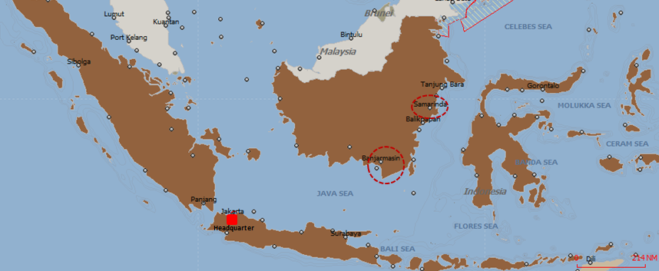

IMC Transshipment in Indonesia
Headquarter in Jakarta.
Branch offices in Samarinda and Banjarmasin.
Tug and barge employment locations: 13 sets in Samarinda area and 15 sets in Banjarmasin area, with annual carrying capacity up to 7 million tons.
Floating Loading Facility employment locations: 2 units in Samarinda anchorage and 2 units in Banjarmasin anchorage, with annual carrying capacity up to 33 million tons.

Slide 31
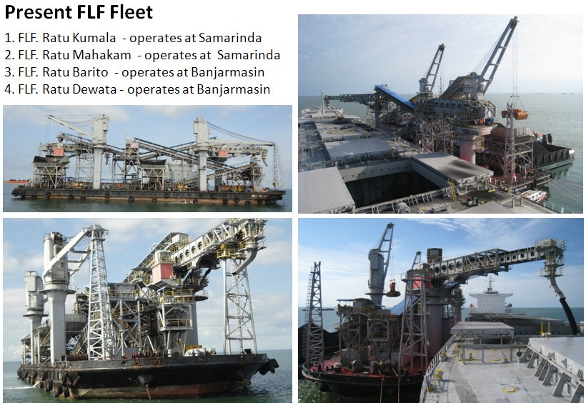
IMC Transshipment in Indonesia

Slide 32
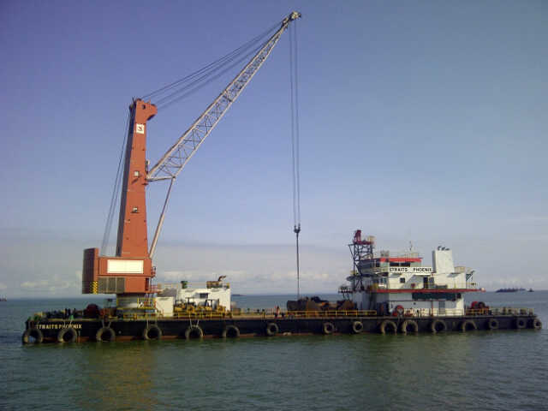
IMC Transshipment in Indonesia
Starting January 2016, PSS operates 1 unit of floating crane called Straits Phoenix.
Loading rate up to 25,000 MT/day.
Craft maintained by International Dual Class (LR and BKI).
Craft equipped with reliable Gottwald Crane with 45 cbm grab and can reach 32 mtr.

Slide 33
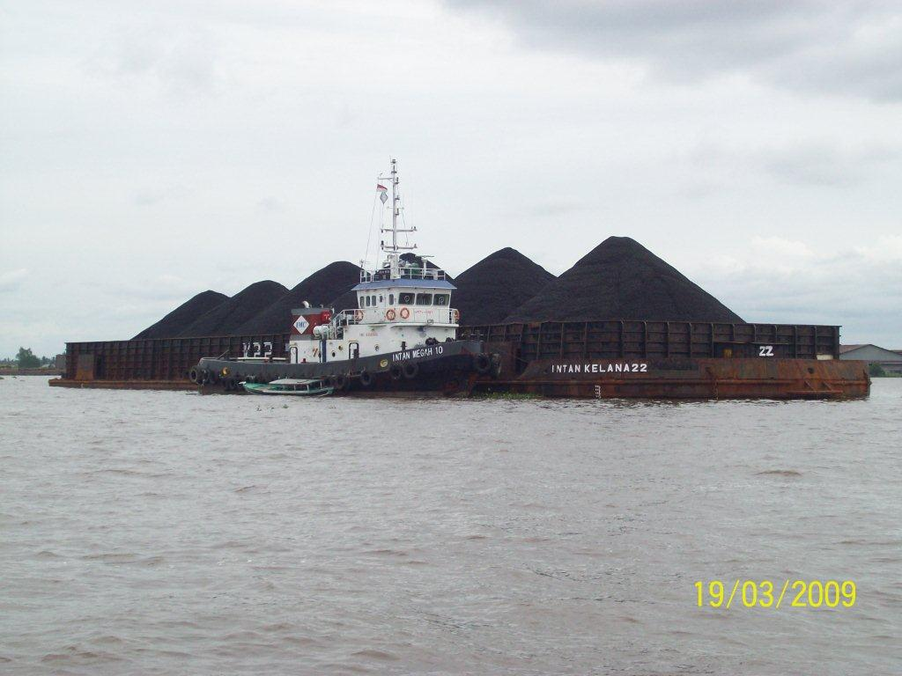
IMC Transshipment in Indonesia
28 sets of 2,000 BHP tug boats and 300 FT barges.
Tugs are dual classed (ABS/NK/BV & BKI). Barges are dual classed (DNV-GL/ABS & BKI).
Equipped with satellite-based vessel tracking and performance monitoring system to consistently monitor speed, bunker consumption, position, engine RPM, and distance.
Notes:
HSSE

Slide 34
万邦海上过驳业务转载简介
IMC Transshipment
菲律宾苏比克湾淡水河谷铁矿石过驳转载
IMC Transshipment at Subic Bay of Philippines for Vale
万邦曾为淡水河谷设计并监督管理二艘VLOC改装成浮式转运站(FTS)船，并管理在菲律宾苏比克湾港口的两艘浮式转运站(FTS)船的生产运营。
  世界上最大的铁矿石转运船Ore Fabrica(2012年)
  世界第二大的铁矿石转运船Ore Sossego(2013年)
转运船作为平台，将淡水河谷40万载重吨的Valemax铁矿石船上的铁矿石货物转运到支线船上，运往中国和其他亚洲市场
Over five years, we cumulatively transshipped nearly 67 million tons of iron ore, involving over 1,200 berthing/departure operations and more than 500 vessels, without any major failures or accidents/injuries.

Slide 35
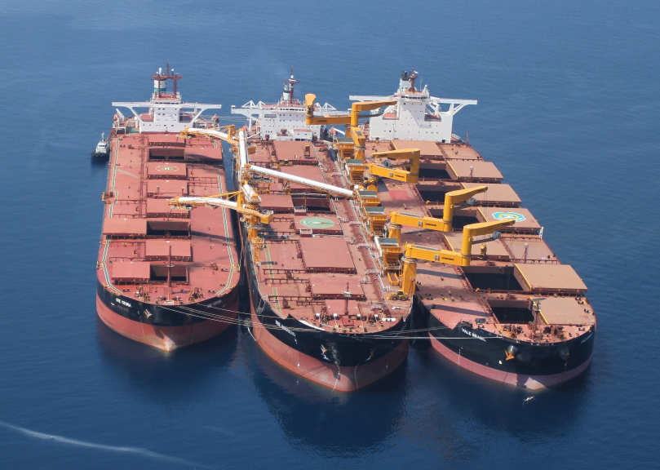
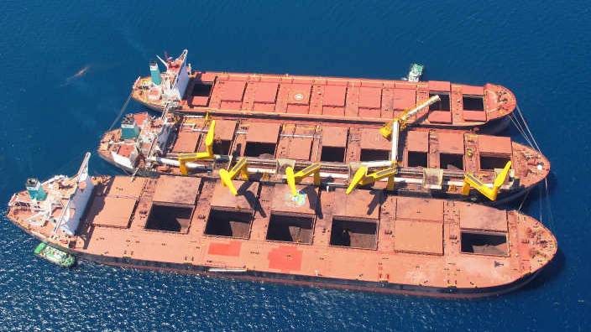
IMC Transshipment at Subic Bay of Philippins
Subic Bay, Philippines – Iron ore – 2 Floating Transfer Stations
FTS 1 – Ore Fabrica
自2012年2月开始运作起重机右舷侧及可移动船用装载机
In Operation Since Feb 2012 Cranes stbd side & movable shiploader
FTS 2 – Ore Sossego
自2013年4月开始运作起重机左舷侧及2个固定的船用装载
In Operation Since April 2013 Cranes Port side & two fixed ship loader

Slide 36
2024年万邦成功打入几内亚铝土矿过驳市场，和几家中外大型铝土矿矿主签订了铝土矿过驳合同。目前共有3艘浮吊船、1艘过驳平台FLF 、12艘驳船以及配套港作拖轮， 形成年过驳运力20mtpa。
万邦海上过驳业务转载简介
IMC Transshipment in Guinea
In 2024, IMC successfully entered the Guinea bauxite transshipment market in Guinea and signed bauxite transshipment contracts with several major domestic and international bauxite mine owners. Currently, the company operates a fleet comprising 3 floating cranes, one transshipment platform (FLF), 12 barges, and supporting harbor tugs, establishing an annual transshipment capacity of 20mtpa.

Slide 37
Thank You！

