Slide 1

16th Aluminium RAW MATERIALS SUMMIT
May 28-29, 2026 | HAIKOU, cHINA
The Alumina and Aluminium supply & Growth in India
Dr. Ashok Nandi, President IBAAS

Slide 2
Can india becomes second largest alumina producer?
At present the installed capacity of alumina in India is about 11.3MTPA, this is likely to increase to 15 MTPA by 2030 through brownfield and greenfield expansions.
There are 3 Greenfield alumina projects announced, which may take India’s alumina production to the level of 23MTPA in the next +10 years and India may occupy 2nd position in the world after the China.
Despite having fairly large bauxite resources, main issues are location in the tribal belts, ecologically sensitive areas and delays in environmental clearances.

Slide 3
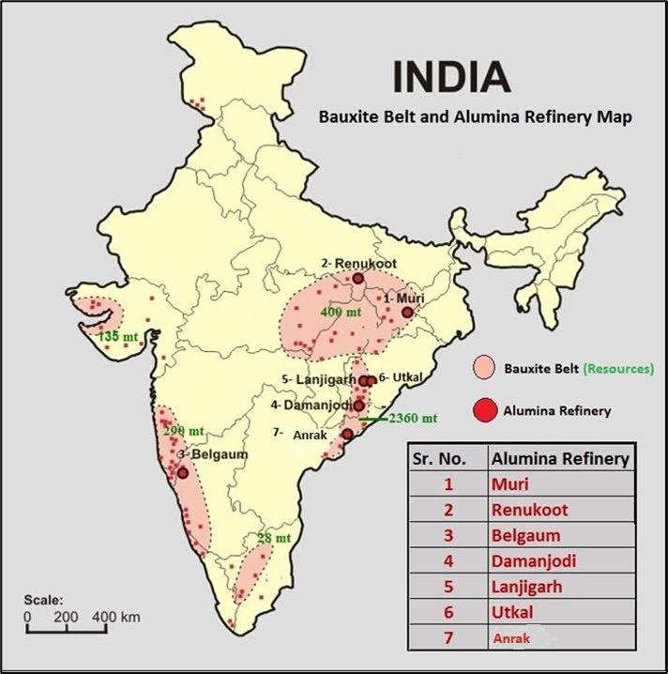
Bauxite Mines and Alumina Plants INDIA

Slide 4
ALUMINA REFINERIES OF INDIA – EXISTING

Slide 5
ALUMINA REFINERIES OF INDIA (CONTD.)

Slide 6
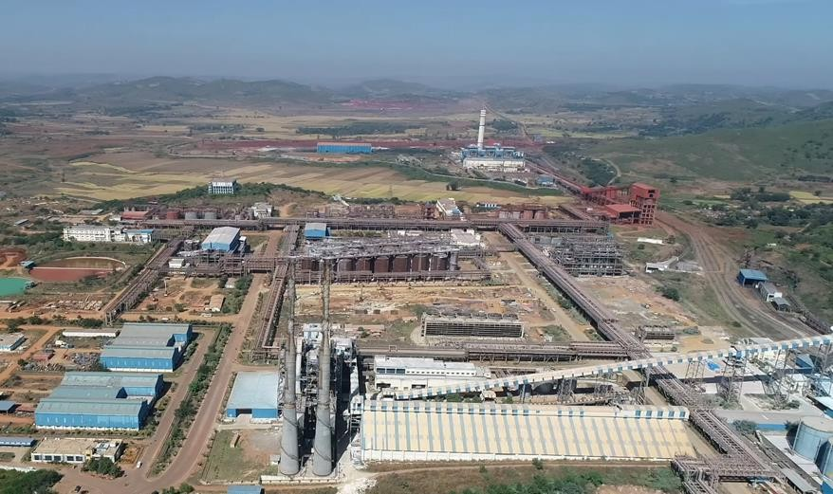
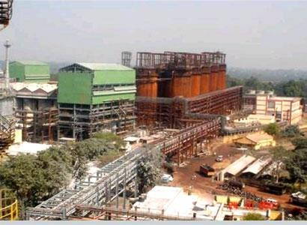
Alumina Refineries
Utkal Alumina Refinery of India
(2.6 MTPA –One of the Cheapest
Alumina Producers of the World)
Hindalco- Muri
India’s old
Alumina refinery

Slide 7
World alumina scenario
China is the leader in alumina production in the world. Australia is far behind, followed by India, Brazil, Russia and other countries.

Slide 8
GREENFIELD ALUMINA REFINERIES

Slide 9
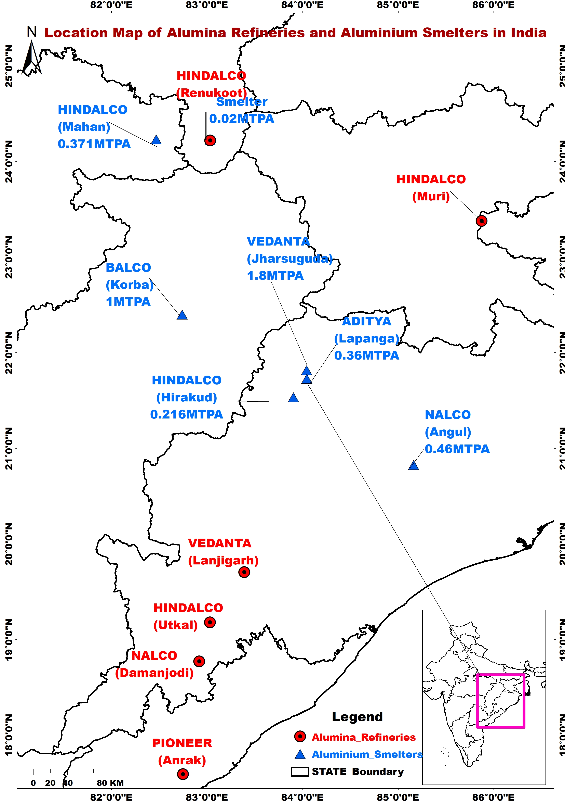
Indian alumina refineries and smelters are mainly concentrated in the Eastern part of country in the states of Odisha, Jharkhand, AndHra Pradesh (AP), Madhya Pradesh (MP) and Uttar Pradesh (UP).

Slide 10
ALUMINIUM SMELTERS INDIA

Slide 11
New ALUMINIUM SMELTERS INDIA

Slide 12
World aluminium scenario
China is again a leading aluminium metal producer. Second is India, however, it is far behind, followed by Russia, Canada and UAE.

Slide 13
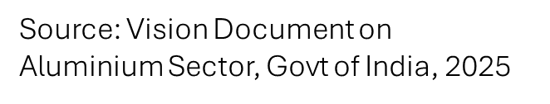
aluminium metal forecast india
India has reached a stage where it produces 4.16 MTPA of Primary Aluminium and 1.8 MTPA in the secondary sector.
According to Vision document of Govt India (2025) it is estimated that India’s domestic Aluminium demand will be -
  Short-term (FY24-FY30): 8.5 MT by FY30
  Medium-term (FY31-FY40): 18 MT by FY40
  Long-term (FY41-FY47): 28 MT by FY47

Slide 14
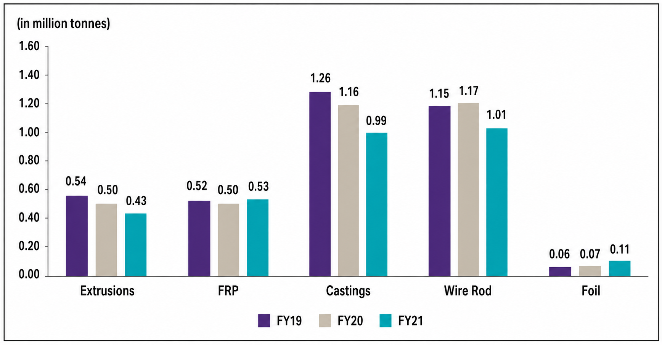
Production of Downstream Products in India
Source: Vision Document on Aluminium Sector, Govt of India, 2025

Slide 15
SECONDARY RECYCLED aluminium
The secondary capacity of ~2.0 MT of India is largely dependent on imported scrap.
Although the share of secondary Aluminium consumption in India has increased over the years, the availability of domestic scrap and sourcing scrap from other nations have been challenging.
Production from domestic scrap is projected to reach an incremental 6 MTPA by FY2047.

Slide 16
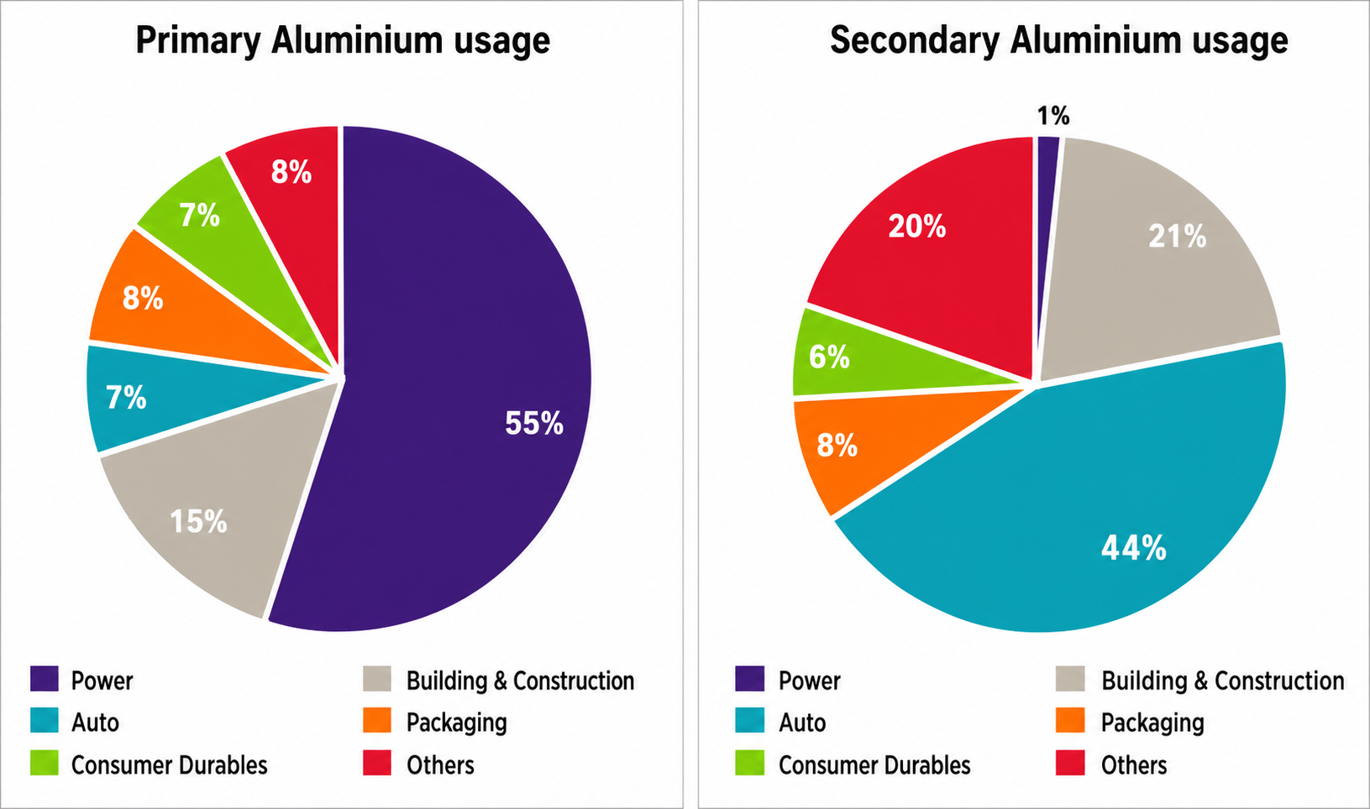
Primary & Secondary Aluminium Usage in India

Slide 17
CONCLUSIONS
India’s present installed capacity of alumina is about 11.2 MTPA, far behind of China and Australia. This is almost equal to Brazil’s alumina production.
The alumina industry is now rapidly developing in India and likely to produce 15 MTPA by 2030 surpassing Brazil and Australia.
In metal production, India is second with 4MTPA primary and about 2 MTPA recycled aluminium.

Slide 18
CONCLUSIONS (Contd.)
India’s primary aluminium metal production may increase to maximum 6MTPA and secondary metal may be 2.5 MTPA by 2030, which may more or less meet the internal demand.
The depleting high grade bauxite resources will require significant changes in the existing alumina technology to process high silica and iron contaminated ore.
Efforts are being made to produce Green Aluminium and partly replace thermal power by Green energy and small modular reactors.

Slide 19

Status of Bauxite, Alumina and Aluminium Industry of Vietnam
16th ALUMINIUM RAW MATERIALS SUMMIT
May 28-29, 2026 | HAIKOU, CHINA
Dr. Ashok Nandi, President
International Bauxite, Alumina and Aluminium Society (IBAAS)

Slide 20
Introduction
Vietnam hosts one of the world's largest bauxite resources, estimated at approximately 5.8 billion metric tons, ranking third globally after Guinea and Australia.
Despite this extraordinary resource base, translating reserves into economic value remains constrained by structural and operational barriers.

Slide 21
Overview & Distribution
Major bauxite deposits are located in Vietnam’s Central Highlands (Tây Nguyên), mainly in Dak Nong and Lam Dong provinces.
Smaller bauxite occurrences are also found in northern Vietnam.
Deposits are lateritic in nature with medium alumina content and requires washing to reduce silica content.
Key alumina refineries: Tan Rai and Nhan Co. Each refinery has an annual production capacity of ~650,000 tons.

Slide 22
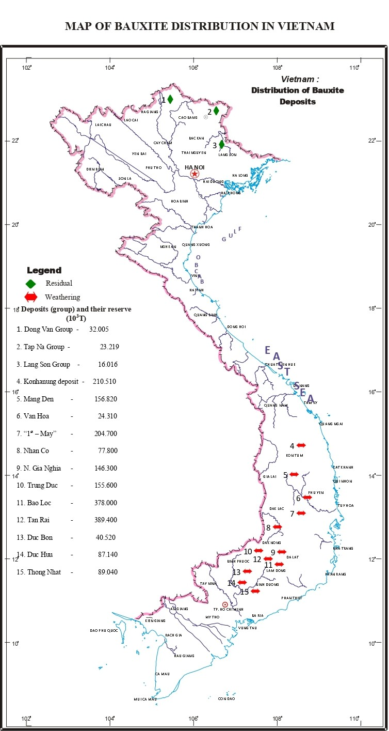
Deposit Locations & Key Industrial Facilities
Central Highlands (Tây Nguyên)
The primary bauxite belt spans Dak Nong and Lam Dong provinces.
Northern Occurrences
Smaller diasporic bauxite deposits exist in the northern provinces of Cao Bang, Lang Son, Ha Glang.

Slide 23
Gibbsitic Bauxite — Central Highlands
The Central Highlands represent Vietnam's most significant bauxite resource with total primary ore estimated at 11.2 Gt bauxite.
Region | Primary Ore
Dak Nong Area | 6316.9
Bao Loc–Di Linh Area | 2,427.8
Kon Plong–Kon H'Nung Area | 614.9
Binh Phuoc Area | 1,312.7
Van Hoa / Tan Phu Areas | 547.0
Total | 11,219.3
Dak Nong alone accounts for over 56% of total primary ore resources, making it the focal point for future large-scale development.

Slide 24
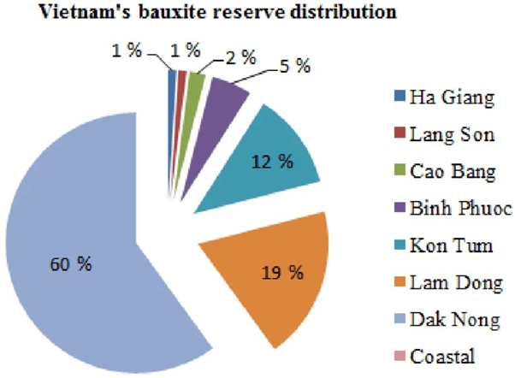
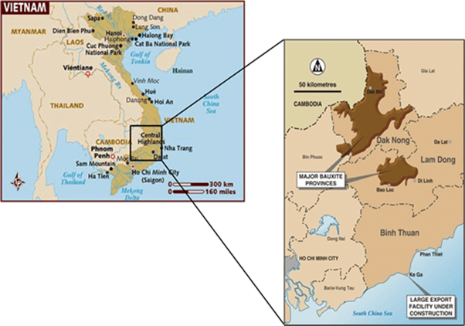
Central Highlands — Deposit Maps
The maps below illustrate the spatial distribution and relative scale of major gibbsitic bauxite deposits across Vietnam's Central Highlands, confirming the concentration of resources in the Dak Nong and Bao Loc–Di Linh corridors.

Slide 25
Chemical Composition
The Central Highlands gibbsitic bauxite exhibits lower silica content (1.6-5% SiO₂) compared to northern deposits (4-15% SiO₂), making it more suitable for alumina production.
Region | Al2O3 (%) | SiO2 (%) | Fe2O3 (%) | TiO2 (%)
North | 42 - 57 | 4 - 15 | 20 - 29 | 2 - 4
Highlands | 42 - 53 | 1.6 - 5 | 17 - 22 | 2 - 3
Table : Average chemical compositions of beneficiated bauxite

Slide 26
Mining Operation & Production
Current Production Status
Vietnam bauxite production: ~4.2 million tonnes/yr.
Estimated reserves managed by VINACOMIN: ~260 million tons.
Major Mining Projects
Tan Rai Mine (Lam Dong Province)
Nhan Co Mine (Dak Nong)

Slide 27
Refining and Smelting
Alumina Production
Production growth driven by Tan Rai & Nhan Co refineries
Current combined refinery output: ~1.5 million Mt/year
Processing Technology
VINACOMIN focus: Technology development & process optimization
Environmental initiative: Dry red mud handling
Objective: Reduced environmental risk
Future Smelting Capacity
2021–2030 target: 120,000–150,000 tons/year
2031–2050 target: 225,000–245,000 tons/year
Focus: Gradual aluminum smelting expansion

Slide 28
Diasporic Bauxite — Northern Vietnam
Diasporic bauxite deposits in the northern provinces total approximately 190 Mt of primary ore, equivalent to 87 Mt of beneficiated bauxite after processing to improve alumina grade and reduce impurities.
Region | Reserves (Mt) | Resources (Mt) | Total (Mt)
Ha Giang Area | 1.396 | 11.352 | 12.748
Cao Bang Area | 4.758 | 35.769 | 40.527
Lang Son Area | 16.667 | 17.073 | 33.740
Total | 22.821 | 64.194 | 87.015
Cao Bang holds the largest total resource base at 40.5 Mt, while Lang Son leads in confirmed reserves at 16.7 Mt.

Slide 29
Red Mud Management
Status Red Mud Disposal Challenges
Generation rate: 1–2 tons per ton of alumina
Nature: Highly alkaline waste (pH 10–13)
Environmental Concerns
Groundwater contamination risk
Tailings dam failure risk
Large-volume long-term storage
Land usage impacts
Dust generation issues

Slide 30
A Foundation for Vietnam's Aluminium Future
With the third-largest bauxite reserves in the world and two operating alumina refineries, Vietnam stands at an inflection point. Realizing the full value of this endowment demands coordinated investment in infrastructure, environmental stewardship, and advanced processing technology.
5.8 billion tons
Total estimated bauxite reserves — #3 globally
1.3 Mt/yr
Combined alumina refining capacity at Tan Rai & Nhan Co
87 Mt
Beneficiated diasporic bauxite in Northern Vietnam
350 Mt
Beneficiated gibbsitic bauxite in Central Highlands

Slide 31
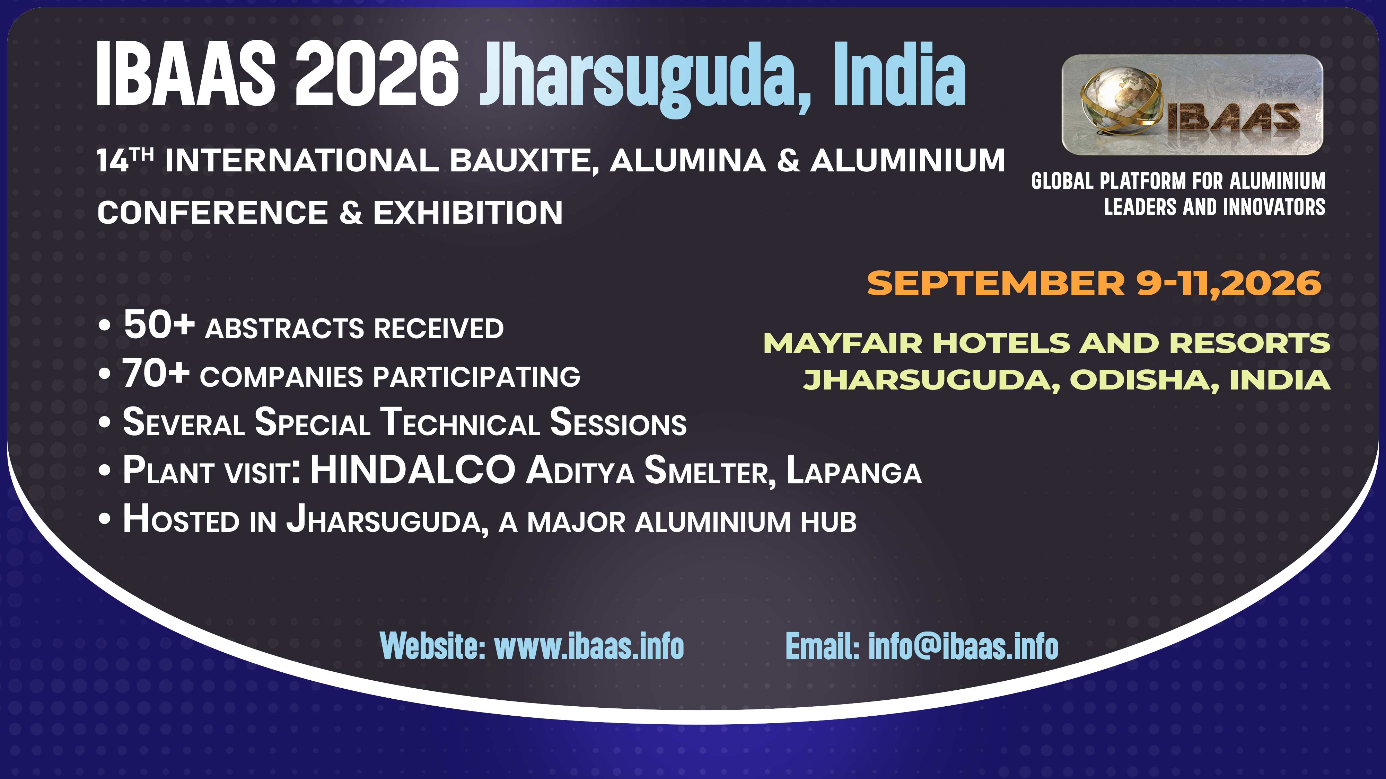

Slide 32
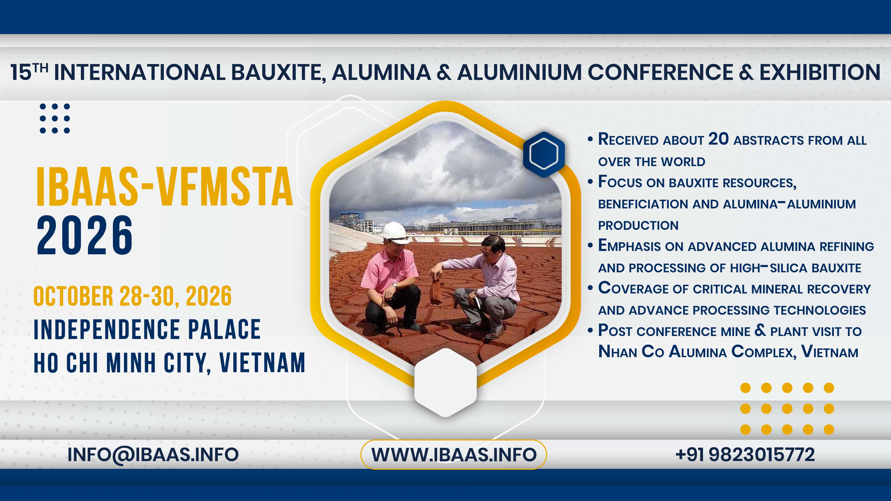

Slide 33
Thank You
Dr. Ashok Nandi
President, IBAAS
Email: ashok.nandi@ibaas.info; info@ibaas.info
Website: www.ibaas.info

