Slide 1
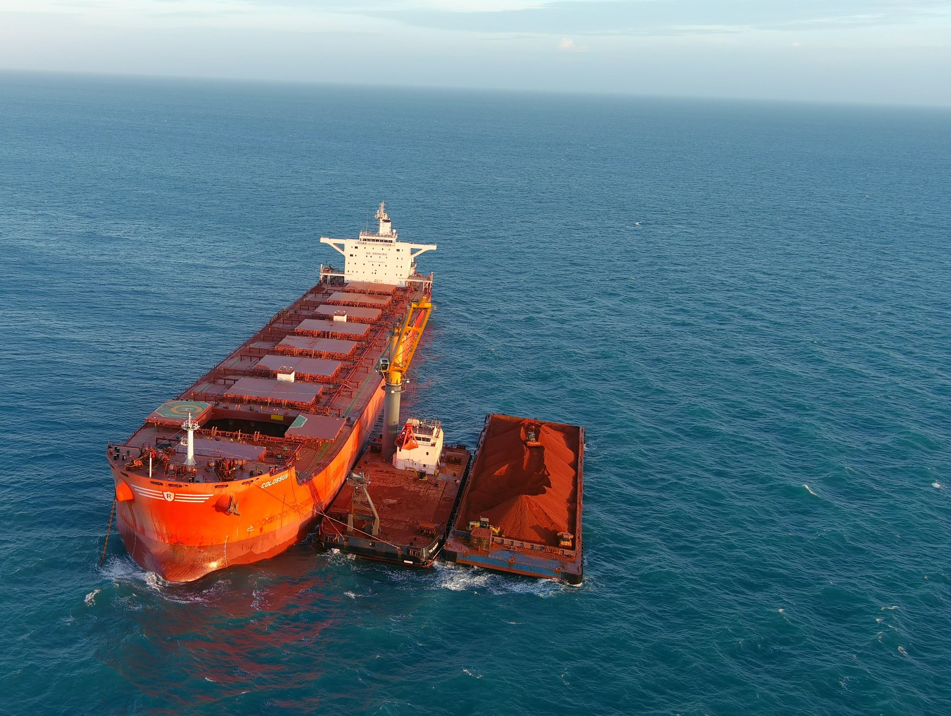

澳大利亚铝土矿开发及出口
Australian Bauxite Development and Export
大会特邀演讲嘉宾 - Speaker- CEO Simon Wensley
2023.05.19, Asian Metal Conference, Xiamen, China

Slide 2

COMPETENT PERSON’S STATEMENT主管人员声明
Any information in this report that relates to the Bauxite Hills Mine Mineral Resource is based on information compiled by Ed Radley who is a consultant to Metro Mining and a Member of the Australian Institute of Mining and Metallurgy (MAusIMM). Mr Ed Radley has sufficient experience which is relevant to the style of mineralisation and type of deposit under consideration and to the activity which he is undertaking to qualify as a Competent Person as defined in the 2012 Edition of the ‘Australasian Code for Reporting of Exploration Results, Mineral Resources and Ore Reserves’.
Mr Ed Radley has consented in writing for inclusion in this Report the matters based on the information in the form and context it appears
本报告中与铝土矿山矿产资源有关的任何信息均基于Ed Radley汇编的信息，他是梅特罗的顾问，也是澳大利亚采矿和冶金协会（MAusIMM）的成员。Ed Radley先生具有足够的经验，与所考虑的矿化类型和矿床类型以及他为获得2012年版《澳大利亚勘探结果、矿产资源和矿石储量报告规范》中定义的合格人员资格而开展的活动有关。
Ed Radley先生已以书面形式同意将基于其所显示的形式和上下文的信息的事项纳入本报告。
IMPORTANT INFORMATION重要信息
The purpose of this presentation is to provide general information about Metro Mining Limited (Metro
or the Company) and its subsidiaries and business.
本演示文稿的目的是提供有关梅特罗矿业有限公司（梅特罗或公司）及其子公司和业务。
NO OFFER OF SECURITIES不提供证券
This presentation is for information purposes only and does not constitute or form any part of any offer, invitation or advertisement to sell or issue securities or other financial products in any jurisdiction. It is not a prospectus, disclosure document, product disclosure statement of other document or contract under Australian Law or any other law. This presentation and its content must not be distributed, transmitted or viewed by any person in any jurisdiction where the distribution, transmission or viewing of this document would be unlawful under the securities or本演示仅供参考，不构成或构成在任何司法管辖区出售或发行证券或其他金融产品的任何要约、邀请或广告的任何部分。它不是澳大利亚法律或任何其他法律规定的招股说明书、披露文件、产品披露声明或其他文件或合同。根据该司法管辖区或任何其他司法管辖区的证券或其他法律，本演示文稿及其内容不得由任何司法管辖区内的任何人分发、传输或查看。
other laws of that or any other jurisdiction.
COMPETENT PERSON’S STATEMENT主管人员声明
Any information in tis report that relates to the Metro Mining Bauxite Hills Reserves is based on information compiled by MEC Mining and reviewed by Grant Malcolm, a Competent Person who is a Member of the Australasian Institute of Mining and Metallurgy. Grant Malcolm is a full-time employee of MEC Mining Pty Ltd. Grant Malcolm has sufficient experience that is relevant to the style of mineralization, type of deposit under consideration and to the activity being undertaken to qualify as a Competent Person as defined in the 2012 Edition of the ‘Australasian Code of Reporting of
Exploration Results, Mineral Resources and Ore Reserves’. Grant Malcolm consents to the inclusion in
the report of the matter based on his information in the form and context in which it appears.
本报告中与梅特罗希尔矿山（Bauxite Hills）储量有关的任何信息均基于MEC Mining汇编的信息，并由澳大利亚采矿和冶金学会成员、合格人士Grant Malcolm审查。格兰特·马尔科姆（Grant Malcolm）是MEC矿业私人有限公司（MEC Mining Pty Ltd.）的全职员工。格兰特·马尔科尔姆（Grant-Malcolm勘探结果、矿产资源和矿石储量。Grant Malcolm同意纳入根据其信息以其出现的形式和背景对此事进行的报告。
FORWARD LOOKING STATEMENT前瞻性陈述
Statements and material contained in this Presentation, particularly those regarding possible or assumed future performance, production levels or rates, commodity prices, resources or potential growth of Metro Mining Limited, industry growth or other trend projections are, or may be, forward looking statements. Such statements relate to future events and expectations and, as such, involve known and unknown risks and uncertainties. Graphs used in this ASX Presentation (including data used in the graphs) may be sourced from third parties and Metro Mining has not independently verified the information. Although reasonable care has been taken to ensure that the facts stated in this Presentation are accurate and or that the opinions expressed are fair and reasonable, no reliance can be placed for any purpose whatsoever on the information contained in this document or on its completeness. Actual results and developments may differ materially from those expressed or implied by these forward-looking statements depending on a variety of factors. Nothing in this ASX Presentation should be construed as either an offer to sell or a solicitation of an offer to buy or sell shares in any jurisdiction.
本演示文稿中包含的声明和材料，特别是关于梅特罗矿业有限公司可能或假设的未来业绩、生产水平或生产率、商品价格、资源或潜在增长、行业增长或其他趋势预测的声明和资料，是或可能是前瞻性声明。此类声明涉及未来的事件和预期，因此涉及已知和未知的风险和不确定性。本澳交所演示文稿中使用的图表（包括图表中使用的数据）可能来自第三方，梅特罗尚未独立验证该信息。尽管已经采取了合理的谨慎措施来确保本演示文稿中陈述的事实是准确的，或者所表达的意见是公平合理的，但无论出于何种目的，都不能依赖本文件中包含的信息或其完整性。实际结果和发展可能与这些前瞻性声明中明示或暗示的结果和发展存在重大差异，具体取决于各种因素。本澳交所演示文稿中的任何内容都不应被解释为在任何司法管辖区出售股票的要约或买卖股票的要约邀请。
COMPETENT PERSON’S STATEMENT主管人员声明
Any information in this report that relates to Exploration Results is based on information compiled by Neil McLean who is a consultant to Metro Mining and a Fellow of the Australian Institute of Mining and Metallurgy (F.Ausimm). Mr McLean has sufficient experience that is relevant to the style of mineralisation and type of deposit under consideration and to the activity being undertaken to qualify as a Competent Person as defined in the 2012 Edition of the ‘Australasian Code for Reporting of Exploration Results, Mineral Resources and Ore Reserves’. Mr McLean consents to the inclusion in the report of the matters based on information in the form and context in which it appears.
本报告中与勘探结果有关的任何信息均基于Neil McLean汇编的信息，Neil McLean是梅特罗的顾问，也是澳大利亚采矿与冶金研究所（F.Ausimm）的研究员。McLean先生具有足够的经验，与所考虑的矿化类型和矿床类型以及正在进行的活动有关符合2012年版《澳大拉西亚勘探结果、矿产资源和矿石储量报告规范》中定义的合格人员资格。McLean先生同意在报告中以其出现的形式和背景纳入基于信息的事项。
KEY RISK FACTORS关键风险因素
Whilst some changes to operating plans have been outlined in this presentation, Metro directs the reader to the comprehensive description of Key Risk Factors outlined in the in the Notes to the financial statements for CY 2021 published 25 February 2022.
虽然本演示文稿中概述了运营计划的一些变化，但梅特罗引导读者参阅2022年2月25日发布的2021财年财务报表附注中对关键风险因素的全面描述。.
2 | ASX : MMI | Apr 2023

Slide 3
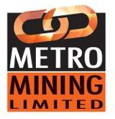

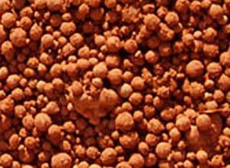
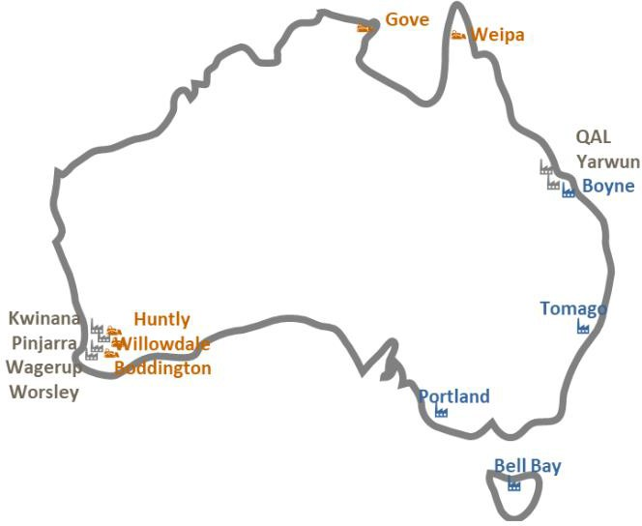


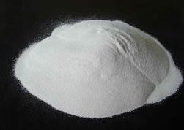

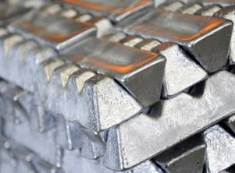
Australia has a fully integrated aluminium industry
澳大利亚拥有完全一体化的铝工业
But has excess bauxite to export to China
但有多余的铝土矿可出口到中国
Metro
3 | ASX : MMI | Apr 2023

Slide 4
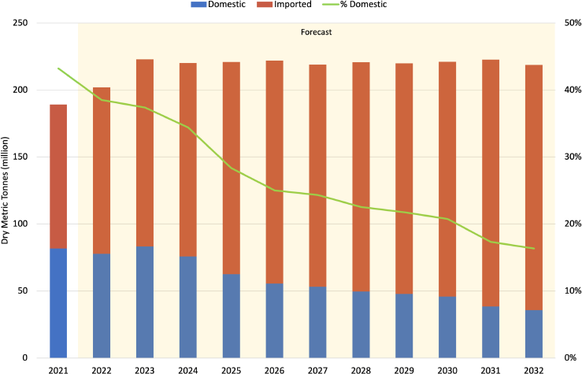
Increasing need Imported Bauxite to China
中国对进口铝土矿的需求增加
Domestic supply falls away, Indonesia supply withdraws
国内供应减少，印尼供应减少
Forecast Sources of Bauxite Consumption China (2021-2032)中国铝土矿消费预测来源（2021-2032）
70% forecast growth in China imports (10 yrs)
中国进口增长70%（10年）
  5% CAGR
  Growing demand from aluminium
  铝需求不断增长
  PLUS以及
  Imports take over from domestic bauxite
  进口接替国内铝土矿
Demand from other nearby regions
附近其他地区的需求
  India 印度
  Middle East 中东
Sources: CM Group
4 | ASX : MMI | Apr 2023

Slide 5
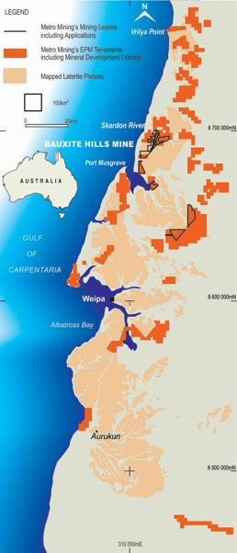
History of Bauxite Mining on Weipa Plateau 韦帕高原铝土矿开采历史
Very Long History of High Quality Bauxite Mining on Weipa Plateau
韦帕高原优质铝土矿开采历史悠久
1963 COMALCO starts production in Weipa
1963年COMALCO在韦帕开始生产
2008 First long term Weipa bauxite contracts to China
2008年首次与中国签订韦帕铝土矿长单合同
2018, 100 km North of Weipa, Metro establish Bauxite
Hills mine
2018年，在韦帕以北100公里处，梅特罗建立了铝土矿希尔矿
2018, Rio Tinto established Amrun Mine
2018年，力拓成立Amrun矿山
Weipa plateau has High alumina 50%+; Silica 8-12% 韦帕高原拥有铝土矿品位：铝50%+；硅8-12%
Rio Tinto Weipa/Amrun: 571 Mt Resources 力拓拥有5.71亿吨韦帕/安然矿资源量
  Export Capacity 24 Mt/a 出口能力2400万吨/年
Metro has 130 Mt Resources
梅特罗拥有1.3亿吨资源量
  High alumina bauxite, direct shipping ore 高铝铝土矿，直运矿石
  Export capacity approx. 4 Mt/a; Expansion to 7 Mt/a underway出口能力约为400万吨/年；正在扩建至700万吨/年
RIO TINTO
5 | ASX : MMI | Apr 2023

Slide 6
品质及储量 Quality and Reserves
Australia has proven bauxite reserves of approximately 9 billion tons, ranking second in the world with an annual production capacity of over 100 million tons, ranking first in the world.
澳大利亚已探明铝土矿储量约90亿吨，为全球第二，年生产能力1亿余吨，居全球第一。
MMI is an Australian listed mining company with an annual production plan of 6 to 7 million tons next year, with sufficient bauxite reserves to be mined for about 20 years.
澳大利亚梅特罗矿业公司是澳大利亚一家上 市的矿业公司，明年计划年产600-700百万吨， 拥有足够再开采约20年的铝土矿储量。
MMI bauxite is similar to RTA’s Weipa bauxite.
梅特罗矿石的品质与力拓的韦帕矿相似。
Main Components of Australian Bx
澳大利亚铝土矿主要成份：
氧化铝Al2O3 | 49-55%
二氧化硅SiO2 | 8-12%
三氧化二铁Fe2O3 | 10-12%
灼减LOI | 25%
附着水 Free Moisture | 11-14%

Slide 7



North Australian Bauxite has large freight advantage
北澳大利亚铝土矿具有巨大的海运优势
Transit time to China: Guinea 45 days vs N Australia 10 days至中国的海运时间：几内亚45天vs澳大利亚北部10天
Guinea: Panamax to Newcastlemax
Metro: Capesize Rio Tinto: Panamax
6 | ASX : MMI | Apr 2023

Slide 8
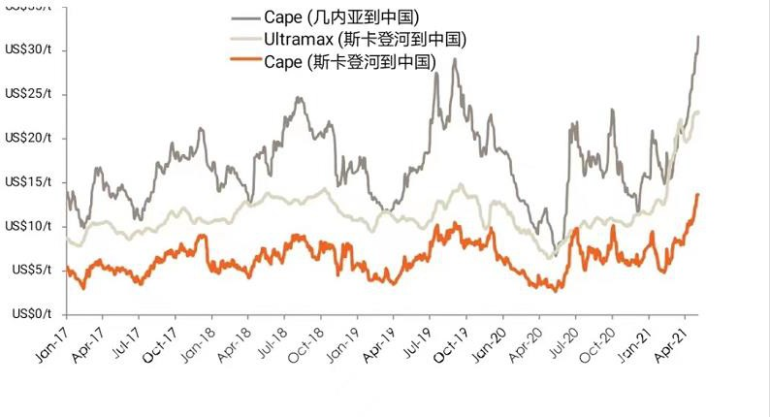
距离和时间 Distance and Delivery Time
Transit time from Australia to Northern China Ports is 10-11 days and the time to Southern China Ports is only 8.5-9 days.
While the transit time from Guinea to Northern China Ports is 45 to 50 days and the time to Southern China Ports is 43 to 48 days
澳大利亚到中国北方港口的海运时间为10-11天，到中国南方港口的时间只需要8.5-9天。而几内 亚铝土矿到中国北方港口的时间需45-50天，到 中国南方港口的时间也需要43-48天，相差一个多月。
Distance from Australia to Northern China Ports is only over 3000 nautical miles, which is only a quarter of the long-distance distance from Guinea.
澳大利亚铝土矿到中国北方港的海运距离仅为3000多海哩，仅为几内亚长距离的四分之一。

Slide 9
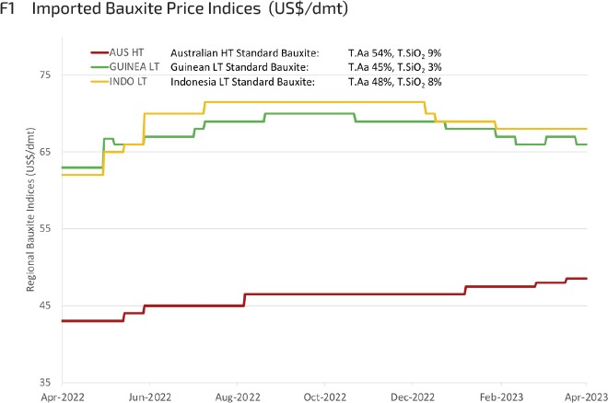
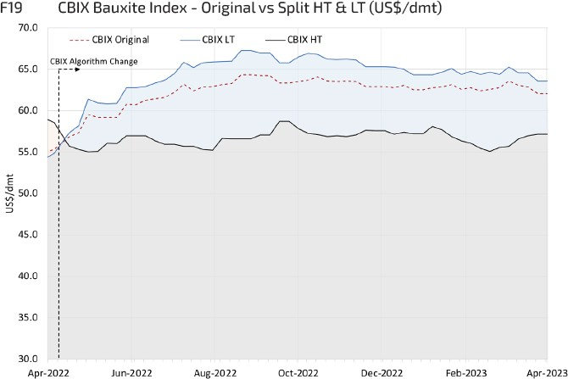

Application of Metro Bauxite in Chinese HT plants
梅特罗矿在多家中国氧化铝厂的应用
Bauxite Prices CIF China(US$/DMT)
铝土矿CIF中国价格（美元/DMT）
Bauxite Prices VALUE IN USE BASIS (US$/DMT)
铝土矿价格使用价值（美元/DMT）
Australian High temp Bauxite Prices Rising
澳大利亚高温铝土矿价格上涨
But still US$8 /T cheaper to make
alumina than Guinea in Low Temp
但仍比用于低温生产氧化铝的几内亚矿价格低8美金/吨
Source: CM Group

Slide 10
Application of Metro Bauxite in Chinese HT plants
梅特罗矿在多家中国氧化铝厂的应用
Option 1 方案1： Option 2 方案2：
高硫矿与梅特罗矿的混配使用： 梅特罗矿+牙买加矿+印尼矿+本地矿—（大混使用）
Mixed use of high sulfur bauxite and MMI bauxite
MMI bauxite + Jamaican bauxite_ Indonesian bauxite + domestic bauxite
Domestic bauxite: high sulfur; while MMI bauxite has no sulfur content.
国内高硫矿特点： 硅高、硫高、铝含量也高。 而梅特罗矿则几乎无硫。所以在使用过程中效 果很显著。
This blend method can reduce ore costs and can greatly improve the digestion rate of Guinean bauxite.
由于梅特罗矿比其他进口矿价格价格大幅度降低，这种混 配方式比仅使用高价的其他进口矿明显降低了矿石成本， 同时又大大提高了几内亚矿溶出率。
1:1 ratio blend to reduce the negative effect of sulfur.
以1：1配比可基本解决高硫矿的危害，也不存 在有机物的影响。由于高硫矿价格很低，总的 铝土矿成本大幅度下降，实现了降本增效。
Reduces bauxite and caustic soda consumption.
由此明显降低了矿耗，碱耗也在可接受范围，实现了最大 限度的降本增效，提高了利润空间。
This method can be used in refineries using high sulfur bauxite.
此技术可在应用高硫矿的氧化铝厂推广使用。
This method can used in refineries having multiple bauxite sources.
此技术可在采用多种矿源的氧化铝厂推广使用。

Slide 11
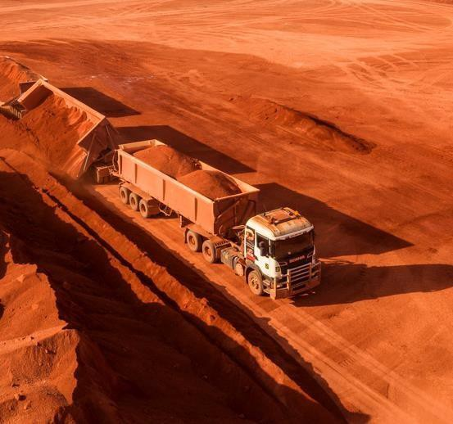
梅特罗矿业有限公司 Metro Mining Limited (MMI)
Metro Mining Limited has become the second major, independent, and reliable Australian bauxite producer in Australia, headquartered in Brisbane, Queensland. Under the leadership of Mr. Simon Wensley, the newly appointed CEO in July last year, this Australian listed company has established a good reputation for adhering to its commitments in the international market, especially in the Chinese market.
梅特罗矿业有限公司已经成为澳洲第二家主要的、独立的、可靠的澳大利亚铝土矿生产商家，总部位于昆士兰布里斯班。在去年七月份新上任的CEO Simon Wensley先生的管理团队领导下，这家澳洲的上市公司在国际市场上，特别是中国市场上，已建立了信守承诺的良好声誉。

Slide 12
梅特罗矿业有限公司(MMI) – 2022
MMI began its initial production and delivery after the rainy season in April 2018. Based on the current reserves, the production service life of the mine can reach 20 years, until 2037.
梅特罗于2018年4月雨季后开始初次生产和交付。按目前的可采储量计算，矿山生产服务年限可达到20年，至2037年。
By 2022, Metro has produced and shipped over 14 million tons of bauxite and shipped it to the Chinese market.
至2022年，梅特罗已累计生产超过1400万吨铝土矿并运往中国市场。
Avg.3 Capesize vessels/month
平均每个月可以装载3大Cape 船。
Production period: April to December of each year.
每年的4到12月是旱季梅特罗的生产期。
1st bauxite mining company in Australia to have its own floating crane. Will purchase a second floating crane to provide customers with more shipping possibilities.
梅特罗是澳大利亚第一家拥有自有浮吊的铝土矿业公司，可转驳17-18万吨海岬级散装船，将采购第二艘浮吊驳船（FCB），配备陆侧筛网和输送机，为客户提供更多装运可能性。
Obtained binding sales contracts for 5 MWMT in 2023 and 6 MWMT in 2024.
已经获得了2023年500万湿公吨和2024年600万湿公吨的具有约束力的销售合同。
MMI’s board of directors has approved the expansion of production capacity by 75% to 7 MWMT per year in 2023, and has successfully raised $30 million for the expansion plan.
梅特罗董事会已批准于2023年将产能扩大75%至每年700万湿公吨，并成功融资3000万美元用于扩建计划
Signed an additional charter party with the shipping company to increase the existing freight volume and ensure smooth delivery.
梅特罗与船公司签订了额外的租船合同以增加现有远期货运量，并确保交货的顺利进行。

Slide 13
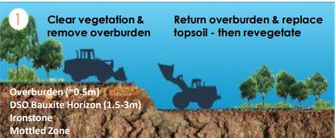
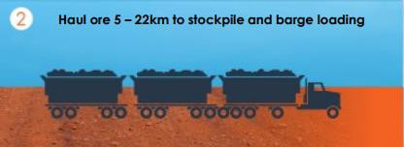
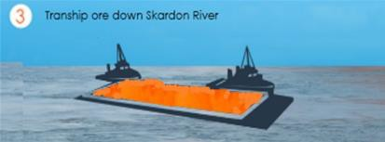
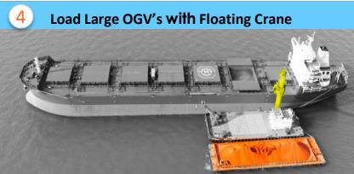
梅特罗自有矿山 – 希尔矿山 Bauxite Hills Mine
Main advantage: Simple mining operations
主要优势：采矿作业简单
Simple open-pit mining requires backfilling and replanting
简单的露天开采，需要回填和复植
Truck transportation to port for simple screening
卡车运输至港口进行简单筛选
The barge towed to the sea through the Skarton River
驳船通过斯卡顿河拖至海上
Transfer to Cape vessel via floating crane
通过浮吊转运至Cape船

Slide 14
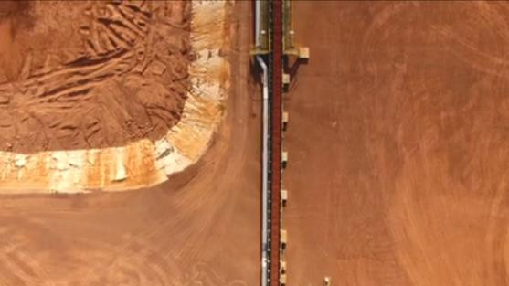
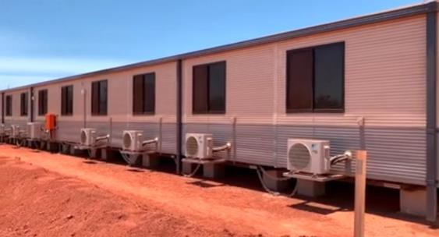
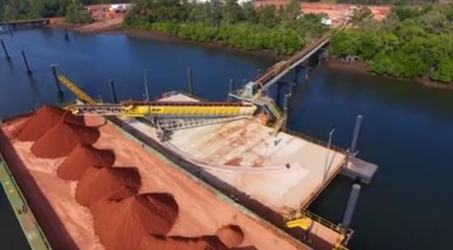
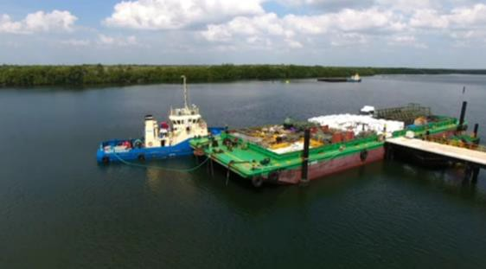
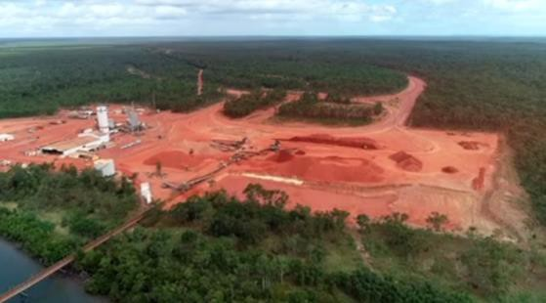
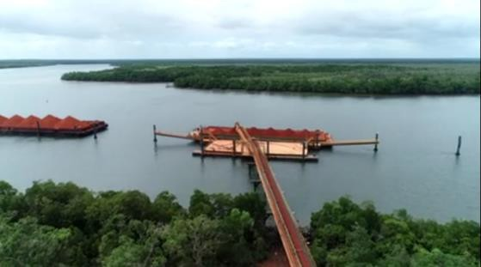
梅特罗自有矿山 – 希尔矿山 Bauxite Hills Mine
Complete mining facilities
完善的矿山设施
Mine offices, tidal gauges, barge docks, barge loading facilities, belt conveyors, etc
矿山办公室、潮汐测量仪、驳船码头、驳船装载设施、皮带输送机等等

Slide 15
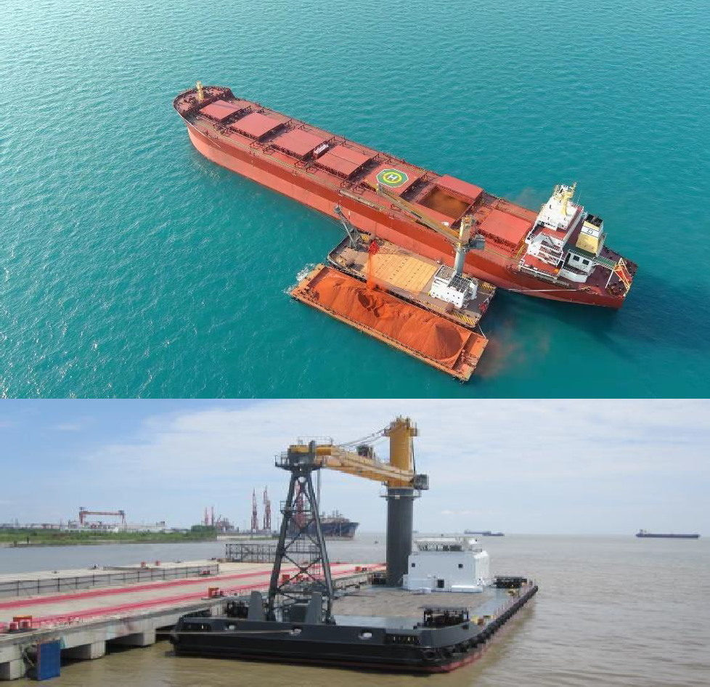
第一艘浮吊已投入使用 First Floating Crane in use
1st floating crane achieved an annual production capacity and transfer capacity of 4 million wet metric tons
第一艘浮吊使梅特罗年产能和倒驳能力达到400万湿公吨。
Load a 180,000 ton vessel at an average speed of 15,000 tons per day.
以平均每天1.5万吨湿吨的速度满载一艘18万吨的好望角（Capesize）型船舶。
MMI ships vessels to various Chinese ports according to customer needs.
梅特罗将根据客户需求，将好望角型船舶发往各个中国港口。
The floating crane platform customized by MMI and its strategic partners has departed from Shanghai Port in China as scheduled in early October 2021 and successfully arrived at Australian ports. It has now safely loaded bauxite for over a year.
梅特罗与其战略伙伴订制的浮吊平台，已经在2021年10月初按期从中国上海港出发，顺利到达澳洲港口，现已安全地装运铝土矿多达一年以上。

Slide 16
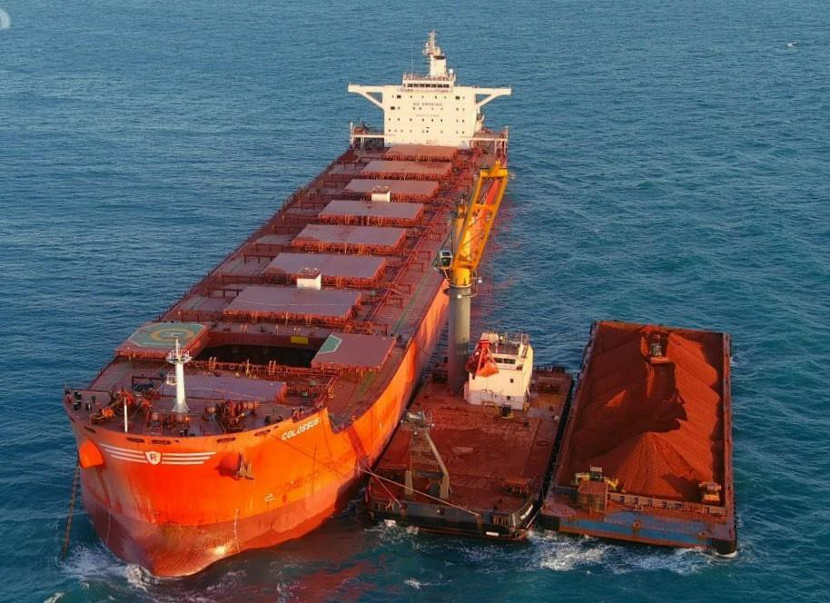
梅特罗将采购第二艘浮吊，配和港口设施的更新以提高运营效 率
Second Transhipping Asset Purchase in Progress
In 2022, MMI decided to purchase a second transhipper and successfully raised $30 million in 2023. If it goes smoothly, it can be put into use after production starts in 2024, which will help implement the expansion plan of MMI in 2024 and beyond.
2022 年末梅特罗决定再购入一个新浮吊， 并于2023 年成功融资300 0 万美金。如果顺利， 2024 年开始生产后， 便可启用，这样有助于梅特罗2024 年及之后的扩产计划实施。
The delivery time for the equipment will be 12 months.
从确定订单开始，设备交付的时间可能为12 个月。
Upgrade of port and barge loading facilities:
港口和驳船装载设施更新：
  Optimize and upgrade existing screening and conveyor equipment;
  优化和升级现有筛选和输送机设备；
  Add a another tugboat;
  增加第三艘拖船；
  Update transportation fleet and related facilities.
  更新运输车队及相关设施。

Slide 17
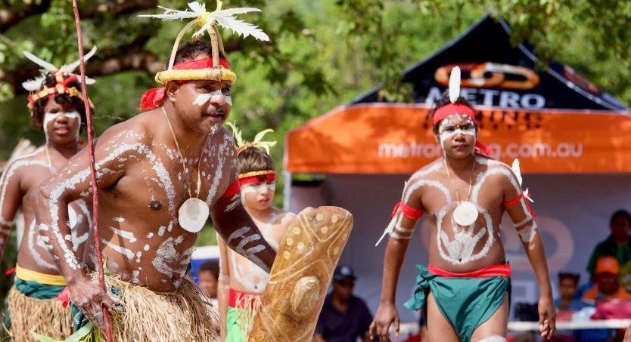
积极的社区关系 Positive Community Relationships
Caring for the continued development and prosperity of the community
关心社区的继续发展和繁荣
Metro becoming a key participant in the Northern Cape York Community
梅特罗成为北开普约克社区建设的主要参与者
Current number of Indigenous employment at 35%, higher than the company's target
当前的原住民就业人数远高于公司目标
Business opportunities for Indigenous communities
已对原住民群体的商机进行评估

Slide 18
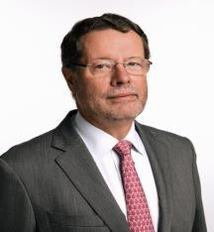
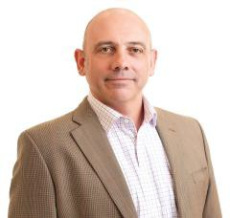

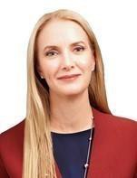
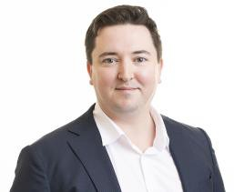
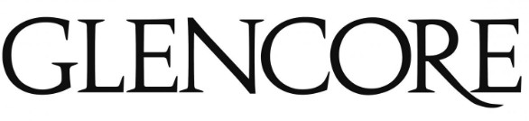
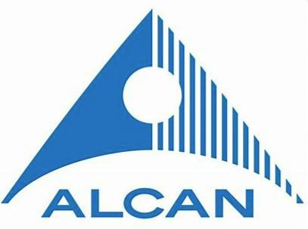

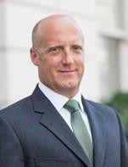
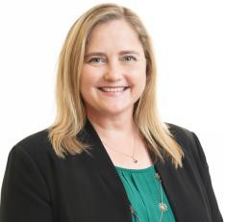
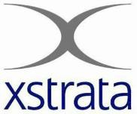
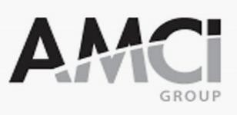
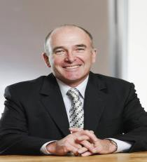




Well Credentialed Board & Management
具有良好资质的董事会和管理层
Significant top-tier mining value chain experience delivering expansion & future shareholder value
Highly Experienced Resources Board
Capable Management Team
Douglas Ritchie道格拉斯·里奇
Non-Executive Chairman非执行董事长
Simon Wensley西蒙·温斯利
CEO & Managing Director首席执行官兼董事总经理
Fiona Murdoch
Non-Executive Director
Nathan Quinlin
CFO
Mark Sawyer
Non-Executive Director
Cherie Everett
GM People & Culture
Andy Lloyd
Non-Executive Director
Gary Battensby
GM Bauxite Hills/SSE
18 | ASX : MMI | Apr 2023

Slide 19
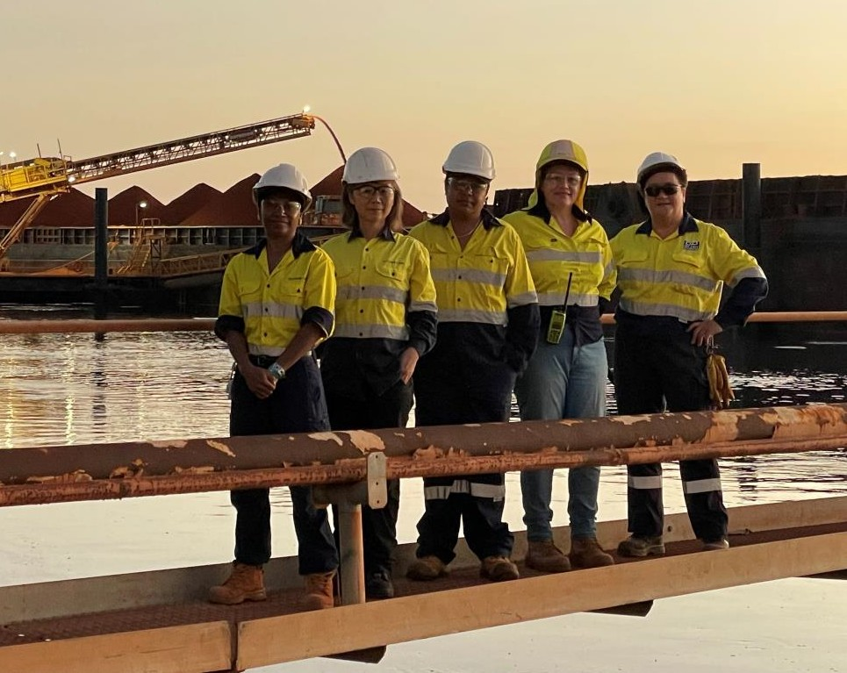
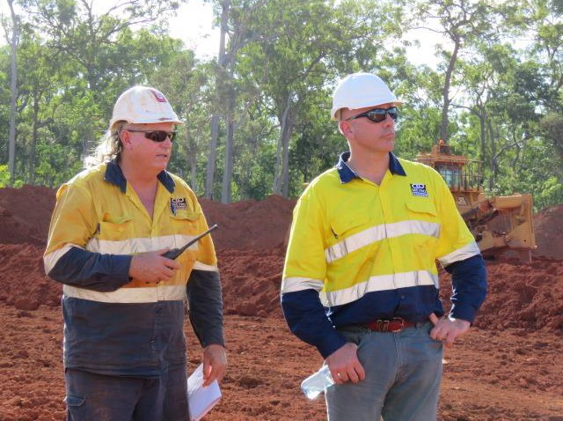
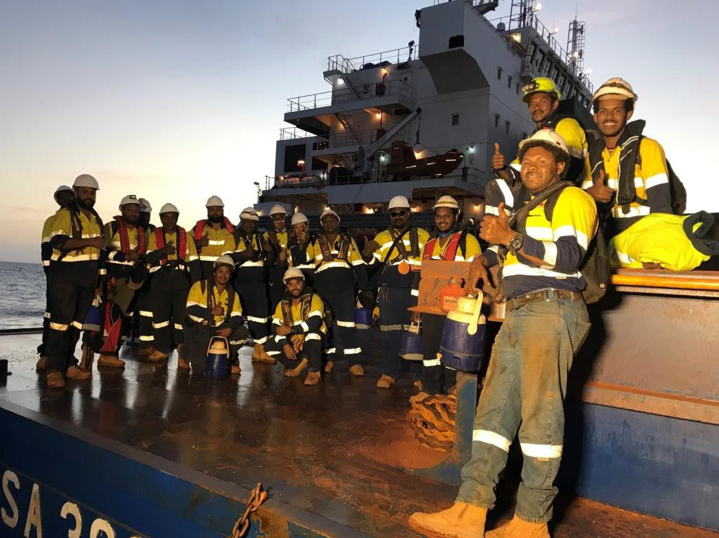
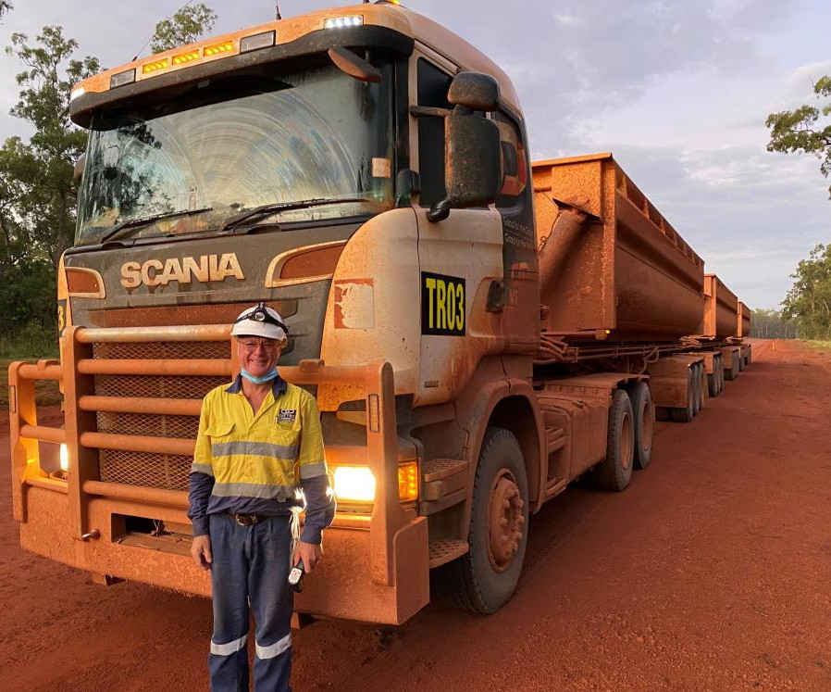
Explore | Define | Mine
THANK YOU!
For Further Information Contact:
Simon Wensley CEO & MD | Mitchell Petrie Co.Sec Ph: +61 (0) 7 3009 8000 | L2, 247 Adelaide St, Brisbane Postal Address: GPO Box 10955, Brisbane Q 4000

