Slide 1
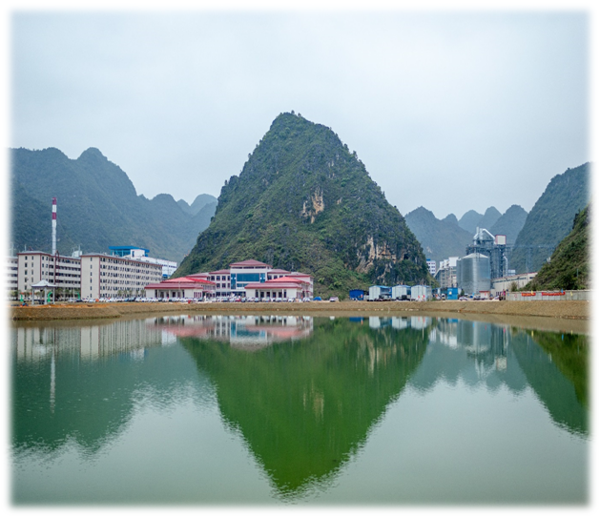
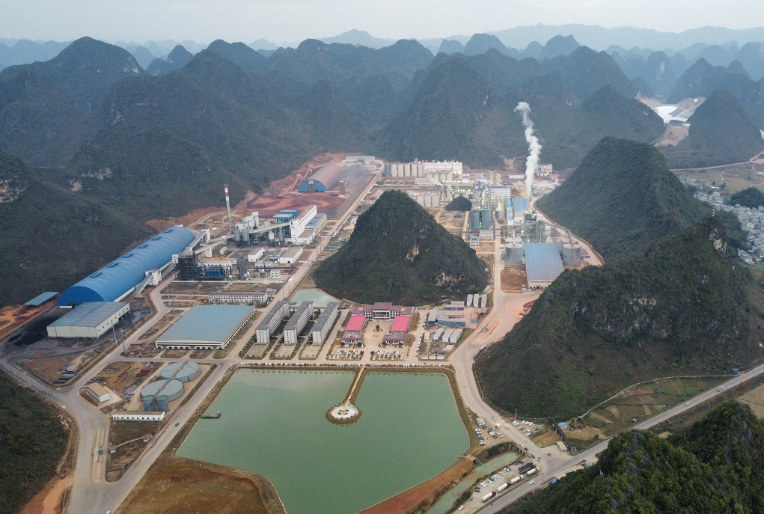
The Alumina Industry Development Advantage in Guangxi and Efficient Utilization of Imported Bauxite
Jingxi Tiangui Aluminum Co., Ltd.
Jiankang Liu
May 2023

Slide 2
Ⅰ
Global bauxite reserves
一
Ⅱ
Imported bauxite
一
Contents
Ⅲ
Development trend of alumina industry in Guangxi
Ⅳ
High quality development direction of alumina industry in Guangxi
一
Ⅴ
Efficient utilization of low-Si gibbsite
一

Slide 3
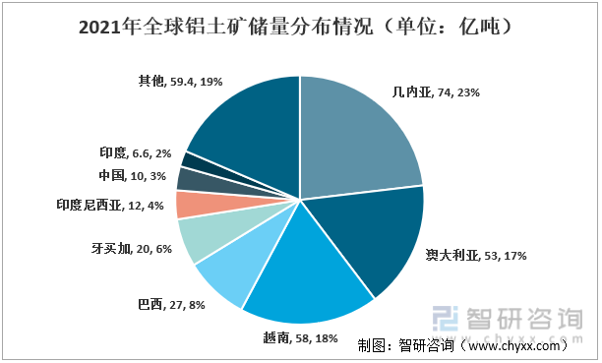
Ⅰ. Global bauxite reserves
According to statistics, the global bauxite reserves in 2021 were approximately 32 billion tons, with Guinea, Vietnam, Australia, and Brazil having the highest reserves. Among them, Guinea's bauxite reserves were approximately 7.4 billion tons, accounting for 23.13% of the world's reserves; Vietnam's bauxite reserves were 5.8 billion tons, accounting for approximately 18.12% of the world's reserves; Australia's bauxite reserves were approximately 5.3 billion tons, accounting for approximately 16.56% of the world's reserves.

Slide 4
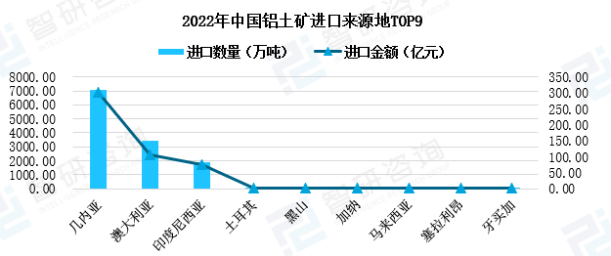
二、国内进口铝土矿分析Ⅱ. Imported bauxite
At present, China’s alumina industry is increasingly dependent on imported bauxite due to the depleting bauxite resources in China. In 2022, China imported 125.7 million tons of bauxite, with a dependence degree of 64% on import. China mainly imported bauxite from Guinea, Australia, Indonesia and other countries. Among them, Guinea is the largest source country, with an import volume of about 70.48 million tons, accounting for 56% of the total import volume. The use of imported bauxite, especially that from Guinea, Southeast Asia and other countries, is the development trend of China's alumina industry.
Import volume and source regions of bauxite in 2022

Slide 5
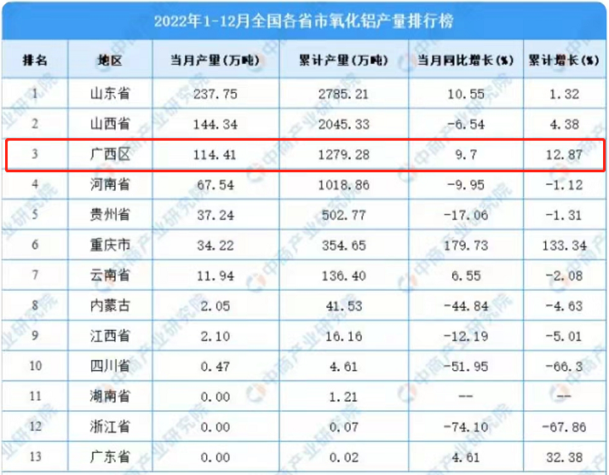
Ⅲ. Development trend of alumina industry in Guangxi
At present, new alumina plants in China are mainly located in coastal areas to facilitate the utilization of abundant bauxite resources abroad. The central government has made a significant strategic decision to develop western China, which has become a hot spot attracting worldwide attention. Guangxi belongs to the western area of China and is the only coastal province in the area. Guangxi is also the south gate of China's maritime transportation, and with its geographical advantage, the transportation cost for importing bauxite is lower compared to northern China. In 2022, Guangxi witnessed alumina production of about 12.79 million tons, ranking third in China. At present, Guangxi has built a production capacity of 15.2 million tons of alumina, and coastal cities are about to invest in four large-scale alumina projects, increasing production capacity by approximately 12.4 million tons. After the projects are put into operation, Guangxi might produce about 27.6 million tons of alumina annually, and it is expected to surpass Shandong and become the largest alumina production province in China. (Location advantage, production foundation of alumina, leading technology)

Slide 6
Ⅲ. Development trend of alumina industry in Guangxi
Statistics of completed/newly built alumina projects in Guangxi
No. | City/County | Company | Capacity (10kt)
1 | Pingguo, Baise | Chinalco Guangxi Branch | 250
2 | Tiandong, Baise | Guangxi Tiandong Jinxin Chemical Co. | 200
3 | Debao, Baise | Guangxi Huayin Aluminum Co., Ltd. | 220
4 | Jingxi, Baise | Jingxi Tiangui Aluminum Co., Ltd. | 250
5 | Jingxi, Baise | Guangxi Xinfa Aluminum & Electricity Co. | 300
6 | Longzhou, Chongzuo | Guangxi Longzhou Xinxiang Ecology Aluminum Co., Ltd. | 100
7 | Fangchenggang | Guangxi Huasheng New Material Co. (phase I) | 200
8 | Fangchenggang | Guangxi Huasheng New Material Co. (phase II) | 200
9 | Fangchenggang | Alumina project of Xinjiang TBEA | 240
10 | Beihai | First phase of GIG alumina project in Beihai | 200
11 | Beihai | Second phase of GIG alumina project in Beihai | 200
12 | Beihai | First phase of Hepu East Hope alumina project | 200
13 | Beihai | Second phase of Hepu East Hope alumina project | 200
 | Total |  | 2760

Slide 7
Ⅳ. High quality development direction of alumina industry in Guangxi
1. The high temperature digestion technology by lime is adopted to treat the imported low-Si gibbsite, so that about 14% of alumogoethite and 3% of boehmite can be fully digested, which can reduce the ore cost and realize the efficient and reasonable use of overseas high-quality bauxite resources.
2. The process technology of “high temperature digestion by adding lime - first stage decomposition at high concentration" can circulate the mother liquor of the system in high concentration, reduce the overall liquid volume by 18% compared with the same period last year, and greatly save the energy consumption during liquid circulation transportation. Under high concentration mother liquor conditions, high circulation efficiency can be achieved, and advanced large pipeline digestion units and evaporators are used, making the comprehensive new steam unit consumption of the high-temperature process lower than 1.7t/t-AO, and enabling the goal of production with high temperature and low energy consumption to be achieved.
3. Refined liquid with low impurity content can be obtained at high temperature by adding lime to reduce the impurity content of alumina products. The sand alumina products with spherical aggregates are obtained by the high concentration first-stage pipe decomposition technology, which further improves the quality of alumina products.
4. Under high temperature digestion conditions, alumogoethite and boehmite are fully digested, resulting in a 12% year-on-year decrease in red mud production rate. Red mud, without the influence of alumogoethite, has a higher grade and recovery rate for iron ore concentrate in red mud beneficiation. According to the experimental results of magnetic separation of red mud from Guinean ore at high temperature, the grade of iron concentrate is up to 54-55% and the recovery rate of iron is up to 40%. It is beneficial to the development of red mud comprehensive utilization technology and promote energy saving and emission reduction.

Slide 8
Ⅴ. Efficient utilization of low-Si gibbsite
5.1 High efficient treatment method of low-Si gibbsite
According to traditional cognition, gibbsite bauxite generally uses the process technology of "low-temperature digestion - low concentration second stage decomposition" to produce alumina, which has low comprehensive energy consumption and production cost. The majority of alumina plants in northern China spend a lot of money to transform high-temperature digestion production lines into low-temperature digestion production lines. Jingxi Tiangui Aluminum proposed for the first time the "high temperature digestion by adding lime - first stage decomposition at high concentration" to treat low-Si gibbsite bauxite to produce alumina. Our production practice results from 2020 to now show that the energy consumption index and technical and economic indicators obtained by this technical route for processing low-Si gibbsite bauxite such as Guinean bauxite are better.

Slide 9
Ⅴ. Efficient utilization of low-Si gibbsite
5.2 Analysis of characteristics of Guinean bauxite
Table 1: Chemical composition of Guinean bauxite (%)
 | Al₂O₃ | SiO₂ | Fe₂O₃ | Ti0₂ | Ca0 | A/S | LOI
Guinean bauxite 1 | 46.59 | 2.34 | 24.45 | 3.35 | 0.07 | 19.9 | 23.2
Guinean bauxite 2 | 46.38 | 5.07 | 20.53 | 2.64 | 0.03 | 9.1 | 24.1
Table 2: Phase analysis of Guinean bauxite
 | Gibbsite | Boehmite | Hematite | Alumogoethite | Kaolinite | Quartz | Andalusite | Anatase
Guinean bauxite 1 | 64.70% | 3.00% | 11.50% | 14.00% | 1.00% | 1.90% | / | 2.00%
Guinean bauxite 2 | 64.00% | / | 13.30% | 9.30% | 3.00% | 2.20% | 4.00% | 1.60%
See Table 1 for chemical composition analysis and Table 2 for XRD phase detection results of low-Si gibbsite bauxite represented by Guinean bauxite. According to the results of chemical composition and phase analysis, Guinean bauxite 1 is characterized by low total silicon content (less than 3.0%), low quartz silicon content (about 2.0%), high alumogoethite content (about 14%), and even a small amount of boehmite (about 3.0%). The alumina in boehmite and alumogoethite needs to react under high temperature conditions, so this type of ore is suitable for high-temperature digestion treatment. However, there is another ore type in Guinea ore. Guinean bauxite 2 has a total silicon content of more than 5%, most of which is in the form of andalusite and quartz, while the content of alumogoethite is less than 10%. Andalusite and quartz will react with alkali at high temperature, so this kind of ore is more suitable for low temperature digestion treatment.

Slide 10
Ⅴ. Efficient utilization of low-Si gibbsite
5.3 Advantages of lime high-temperature digestion process in treating low-Si gibbsite bauxite
5.3.1 Significant improvement in alumina recovery rate and low output rate of red mud
Table 3: Ore composition corresponding to high and low temperature digestion methods (%)
Digestion method | Type | Al₂O₃ | SiO₂ | Fe₂O₃ | A/S | Ratio
Low-temperature | Guinean bauxite | 45.2 | 2.14 | 24.47 | 21.12 | /
High-temperature | Domestic bauxite | 50.5 | 9.8 | 21.05 | 5.15 | 30%
 | Guinean bauxite | 45.07 | 2.23 | 24.73 | 20.21 | 70%
 | Mixed bauxite | 46.7 | 4.5 | 23.63 | 10.38 | /
Table 4: Composition of digested red mud corresponding to high and low temperature methods in actual production (%)
Digestion method | Al₂O₃ | SiO₂ | Fe₂O₃ | Na₂0 | CaO | A/S | N/S | C/S
Low-temperature | 15.95 | 4.5 | 53.41 | 1.48 | 1.75 | 3.54 | 0.33 | 0.39
High-temperature | 12.31 | 10.44 | 46.2 | 5.86 | 10.53 | 1.18 | 0.42 | 1.0
Through the calculation of the above production indexes, it can be concluded that the actual digestion rate of alumina is 83.8% and the η phase is 87.4% by low temperature method. The actual digestion rate of alumina is 86.4% and the η phase is 98.1% by high temperature method. It can be seen that the absolute digestion rate of alumina by high temperature method is 2.6 percentage points higher than that by low temperature method, and the relative digestion rate is 10.7 percentage points higher.

Slide 11
Ⅴ. Efficient utilization of low-Si gibbsite
Table 5: Phase composition of high and low temperature digested red mud from gibbsite
Digestion method | Hematite | Alumogoethite | Hydrogarnet | Monohydrate bauxite | Cancrinite | Rutile
High-temperature | 40.20% | / | 47.30% | / | 12.50% | /
Low-temperature | 40.50% | 32.70% | / | 21.80% | / | 5%
There are three phases of alumina in Guinean bauxite, namely gibbsite, boehmite and alumogoethite. The temperature in low temperature method fails to meet the reaction conditions of boehmite and alumogoethite, so the digestion rate of alumina is low. However, the alumina in boehmite and alumogoethite can be fully digested at high temperature by adding lime with high digestion rate (see Table 5 for the phase composition of red mud digested at high and low temperature).
The recovery rate of alumina digested at high-temperature is high, and the consumption of ore can be reduced by 0.2t/t-AO compared to low-temperature method. The crystal water in boehmite and alumogoethite is released under high temperature, and the yield of red mud per ton of alumina digested is 12% lower than that under low temperature.

Slide 12
Ⅴ. Efficient utilization of low-Si gibbsite
5.3.2 Relationship between lime addition and digestion rate
Table 6: Production data statistics on impact of red mud C/S on digestion rate from 2020 to 2022
Condition | Bauxite entering mill | Digested red mud (average)
Red mud C/S | A/S | Batch | A/S | C/S | N/S | η actual % | η phase %
C/S＜0.8 | 11.34 | 80 | 1.33 | 0.72 | 0.52 | 87.46 | 96.67
0.8≤C/S＜1.0 | 12.22 | 622 | 1.19 | 0.91 | 0.49 | 89.35 | 98.19
1.0≤C/S＜1.3 | 14.67 | 1483 | 1.26 | 1.15 | 0.47 | 90.83 | 98.03
1.3≤C/S＜1.6 | 17.00 | 830 | 1.31 | 1.42 | 0.44 | 91.88 | 97.96
1.6≤C/S | 20.73 | 367 | 1.43 | 1.92 | 0.39 | 92.96 | 97.78
From Table 6, it can be seen that when the C/S of red mud is between 0.8 and 1.30, the relative digestion rate of Al2O3 can all reach 98%, and N/S decreases with the increase of C/S.

Slide 13
Ⅴ. Efficient utilization of low-Si gibbsite
5.3.3 Sedimentation performance and washing efficiency of red mud improve significantly
Through production practice, it has been proven that the high-temperature digestion process needs a large amount of water for washing one ton of red mud. In the red mud washing process, four times of reverse washing are needed, and the liquid caustic soda concentration of the discharged red mud is less than 3g/L. However, the amount of water for washing one ton of red mud at low temperature is small, but it is necessary to use 5-6 times of reverse washing in red mud washing to achieve a concentration of less than 5g/L. Moreover, the high temperature digestion process by adding lime promotes the digestion reaction of alumogoethite in bauxite, which was converted into hematite, and the sedimentation performance of red mud is improved. Our high-temperature digestion process can control the liquid-solid ratio of red mud separation and washing bottom flow liquid to 1.0~1.3, reduce the total alkali concentration of the washing solution to below 50g/L, and the unit consumption of flocculant is less than 150g/t-dry red mud. An alumina plant in Guangxi adopts a low-temperature digestion process, but there is no reaction of alumogoethite, which seriously affects the sedimentation performance of red mud. The liquid-solid ratio of the bottom flow liquid is greater than 1.6, the total alkali concentration of the washing solution is greater than 60g/L, and the unit consumption of flocculant is as high as 400g/t-dry red mud.

Slide 14
Ⅴ. Efficient utilization of low-Si gibbsite
5.3.4 Accumulation rate of organic matter slows down significantly at high temperature by adding lime
We have been using the high temperature digestion process by adding lime to treat the low-Si Guinean bauxite for nearly three years. Up to now, the concentration of refined liquid TOC is less than 6g/L and that of oxalate is less than 1.3g/L. So far, no organic matter removal system has been used, and no adverse effects of organic matter on the production process have occurred. However, an alumina plant in Guangxi adopted the low-temperature digestion process to treat Guinean bauxite. After 5 months of operation, it was forced to start the organic matter removal system, with the concentration of TOC in the decomposed mother liquor maintaining at 16g/L for a long time and the concentration of oxalate reaching 4.2g/L.

Slide 15
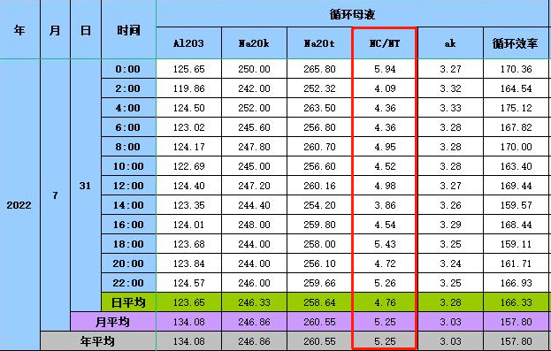
Ⅴ. Efficient utilization of low-Si gibbsite
5.3.5 Carbonate accumulation rate slows down significantly
We adopt the high-temperature digestion process by adding lime with a digestion temperature of 270 ℃. We have been using low-Si Guinean bauxite to produce alumina for over 2 years. Without starting the salt discharge system, the total carbon ratio of the circulating mother liquor remained stable at around 5%. However, within one year of operation of an alumina plant in Guangxi using low-temperature digestion process to treat Guinean bauxite, the total carbon ratio of the system reached over 10%. It can be seen that the high-temperature digestion process by lime greatly slows down the accumulation rate of carbon and alkali in the system.

Slide 16
Ⅴ Efficient utilization of low-Si gibbsite
5.3.6 Technical and economic indicators and energy consumption at advanced level
When the caustic soda concentration of circulating mother liquor increases by 10g/L, the circulating efficiency increases by about 5~6kg/m³- mother liquor. Under normal circumstances, the concentration of circulating mother liquor in high temperature digestion process can be set as 220~240g/L, and that in low temperature digestion process as 190~200g/L. Under the same digestion feed flow condition, the production capacity of high temperature process is 19% higher than that of low temperature process.
The comparison of unit consumption indicators of low-Si Guinean bauxite with high and low temperature processes is shown in Table 9.
Table 9: Comparison of unit consumption indicators of per ton of alumina from Guinea bauxite by high and low temperature processes
Digestion method | Ore consumption | Alkali consumption (kg) | Lime (kg) | High pressure steam consumption (t) | Low pressure steam consumption (t) | Red mud (t)
 | (t)
High-temperature | 2.38 | 48 | 68 | 1.18 | 0.5 | 0.93
Low-temperature | 2.62 | 42.7 | —— | —— | 1.77 | 1.1

Slide 17
Ⅴ Efficient utilization of low-Si gibbsite
Through the comparison of the actual production data of the production technology “efficient utilization of low-Si gibbsite" for low-Si Guinean bauxite treatment, it is concluded that the advantages of the "high temperature digestion by adding lime - first stage decomposition at high concentration" technology are as follows:
1) The relative digestion rate of alumina in the ore increases by 10.7% significantly, the ore consumption per ton of alumina decreases by about 0.2t/t- AO, and the red mud production rate also declines by about 12% significantly.
2) It converts the alumogoethite to hematite completely, improves sedimentation performance of red mud, reduces the unit consumption of flocculant, and enhances the washing efficiency of red mud, providing favorable conditions for iron separation from red mud.
3) Adding a small amount of lime is beneficial for promoting the system's carbonate and organic matter to follow the red mud discharge process, balancing harmful impurities in the system.
4) Comprehensive technical and economic indicators have high cycle efficiency, large production capacity and low comprehensive energy consumption under equipment of the same scale.
5) Production practice has proved that low quartz silica gibbsite, such as Guinean bauxite, washed Vietnamese bauxite, Cambodian bauxite, etc., can adopt the technological route of "high temperature digestion by adding lime - first stage decomposition at high concentration".

Slide 18
Thank You

