Slide 1
Jining Carbon Group Co., Ltd.
Men Yong
2018.05.18

Slide 2
Analysis on Chinese carbon anode supply-demand and the export market

Slide 3
Contents
1
Analysis on Chinese anode
supply-demand relationship in 2018
2
Analysis on anode export data from 2015 to 2017
3
Analysis on anode export market
4
Prediction of anode export market from 2018 to 2019

Slide 4
1
1
Analysis on Chinese anode supply-demand relationship in 2018
3
4

Slide 5
Ⅰ Analysis on Chinese anode supply-demand relationship in 2018
1. Anode output and consumption data from Jan 2016 to Mar 2018 (10,000t)

Slide 6
Ⅰ Analysis on Chinese anode supply-demand relationship in 2018
1. Anode output and consumption data from Jan 2016 to Mar 2018 (10,000t)
Overall anode capacity

Slide 7
Ⅰ Analysis on Chinese anode supply-demand relationship in 2018
2. Anode capacity (newly-added capacity included) and market demand in 2018
Statistics on soon-to-operate capacity of Chinese carbon companies
Company | Built capacity (10,000t) | Newly-added capacity (10,000t)
Shandong Xinfa | 60 | 60
Gansu Hualu | 0 | 15
Liaoning Zhongwang | 25 | 25
Qingzhou Tailong Carbon and Chemical | 12 | 12
Shandong Yinwang Carbon | 0 | 10
Xinjiang Qiya | 30 | 15
Dong'e Hefeng | 15 | 15
Shaanxi Meixin | 0 | 30
Shanxi Huasheng | 6 | 4
Total | 148 | 186

Slide 8
Ⅰ Analysis on Chinese anode supply-demand relationship in 2018
2. Anode capacity (newly-added capacity included) and market demand
Chinese prebaked anode producers’ new projects in 2018
Company | Built capacity (10,000t) | Newly-added capacity (10,000t) | Expected date for starting operation
Shandong Innovation Carbon Material | 0 | 60 | June
Guangxi Qiangqiang Carbon | 70 | 20 | Late September
Sunstone Qili Carbon Material | 0 | 30 | September
Tianlin Baise Mining Tiantian Carbon | 0 | 40 | September
Shandong Zhengxin New Material | 0 | 30 | September
Xinjiang Tianshan | 30 | 30 | October
Shanxi Huaze | 22 | 28 | October
Chibi Changcheng | 12 | 12 | November
Total | 134 | 250

Slide 9
Ⅰ Analysis on Chinese anode supply-demand relationship in 2018
3. Statistics on soon-to-operate capacity of Chinese primary aluminum companies
Province | Company | Current running capacity (10,000t) | Expected newly-added capacity in 2018 (10,000t) | Operation date
Guangxi | Guangxi Laibin Yinhai Aluminum Co., Ltd. | 42 | 17 | Mid-March 2018
 | Guangxi Baise Mining Aluminum Co., Ltd. | 38 | 50 | Early April 2018
 | Guangxi Suyuan Aluminum Co., Ltd. | 8 | 12 | June 2018
 | Guangxi Hualei New Material Co., Ltd. | 25 | 20 | March 2018
 | Guangxi Xinfa Aluminum & Electricity Co., Ltd. | 32 | 10 | March 2018
Inner Mongolia | Inner Mongolia Huayun New Material Co., Ltd. | 65 | 18 | Undetermined
 | Inner Mongolia Mengtai Coal & Electricity Co., Ltd. | 10 | 50 | January 2018
 | Inner Mongolia Chuangyuan Metal Co., Ltd. | 7 | 38 | January 2018
 | East Hope Guyang Plant | 0 | 40 | June 2018
Guizhou | Guizhou Anshun Huangguoshu Aluminum Co., Ltd. | 10 | 3 | April 2019
 | Guizhou Yuping Guangmao Aluminum Co., Ltd. | 0 | 10 | 2018 (accurate date undetermined)
 | Guizhou Xingren Denggao Aluminum Co., Ltd. | 0 | 30 | Undetermined
 | Guizhou Xingren Denggao New Material Co., Ltd. | 0 | 0 | Undetermined
 | Guizhou Huaren New Material Co., Ltd. | 37.5 | 18 | Mid-March 2018

Slide 10
Province | Company | Current running capacity (10,000t) | Expected newly-added capacity in 2018 (10,000t) | Operation date
Yunnan | Yunnan Aluminum Zhaotong Plant | 0 | 35 | August 2018 (provisional)
 | Dali Heqing Plant | 0 | 21 | October 2018 (provisional)
Liaoning | Liaoning Zhongwang Group | 43 | 46 | Undetermined
Gansu | Gansu Zhongrui Aluminum Co., Ltd. (phase one) | 0 | 8 | 9 Apr 2018
 | Gansu Zhongrui Aluminum Co., Ltd. (phase two) | 0 | 40 | November 2018 (provisional)
Shanxi | CHALCO Shanxi Huarun Co., Ltd. | 0 | 50 | Undetermined
Shaanxi | Shaanxi Meixin Industry Investment Co., Ltd. | 0 | 30 | May
Ningxia | SPIC Ningxia Energy Aluminum Co., Ltd. | 99 | 6 | January 2018
Xinjiang | Xinjiang East Hope Nonferrous Metal Co., Ltd. | 80 | 3 | Undetermined
 | Xinjiang Qiya Aluminum & Power Co., Ltd. | 80 | 35 | Undetermined
Total |  | 577 | 590

Slide 11
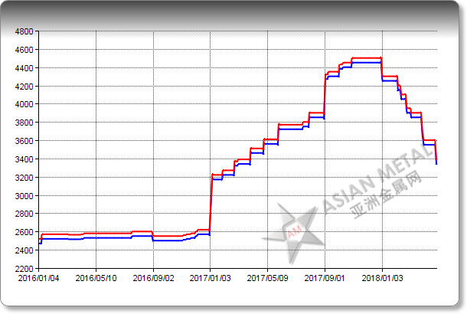
Ⅰ Analysis on Chinese anode supply-demand relationship in 2018
4. Transfer from seller’s market to buyer’s market
Anode price trend

Slide 12
Ⅰ Analysis on Chinese anode supply-demand relationship in 2018
5. Changes of international political environment’s influences on primary aluminum and anode markets

Slide 13
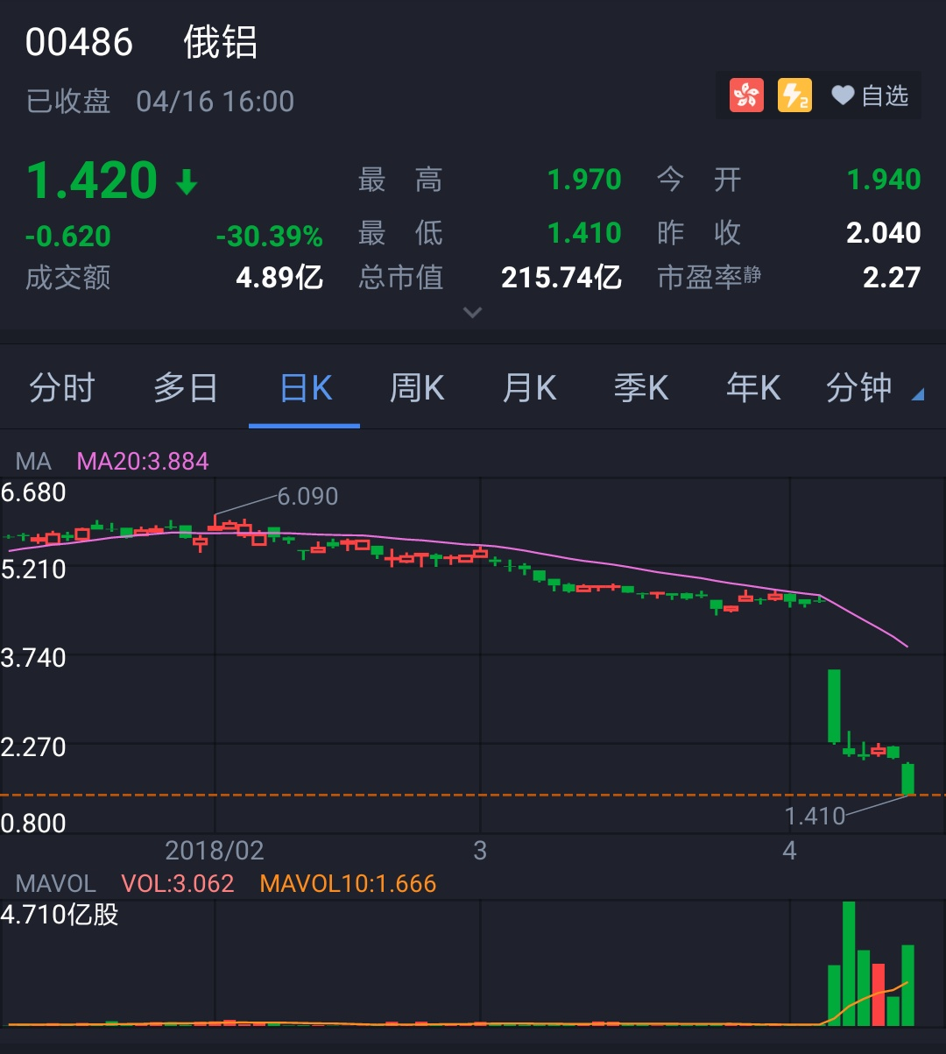

Slide 14
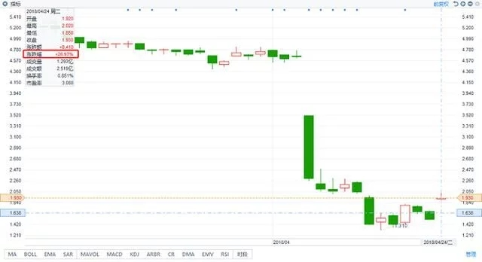

Slide 15
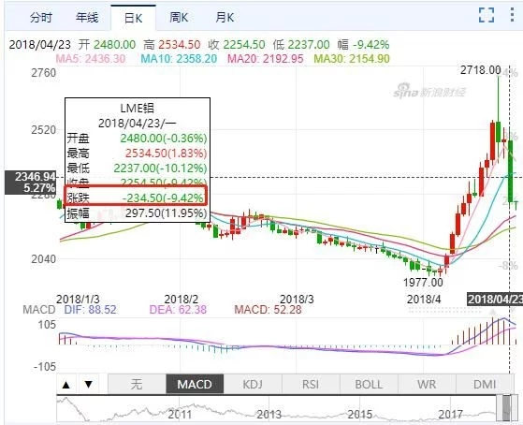

Slide 16
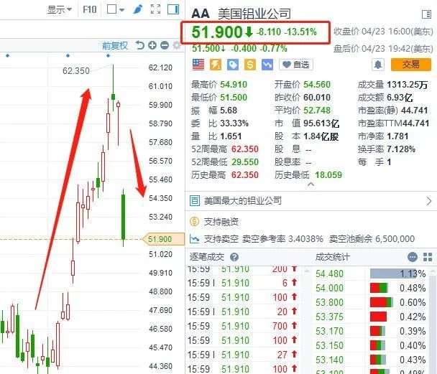

Slide 17
1
2
Analysis on anode export data from 2015 to 2017
3
4

Slide 18
Ⅱ Analysis on anode export data from 2015 to 2017
1. Export statistics
Statistics on total anode export from 2015 to 2017 (ton)
2015 | 2016 | 2017
1,071,263 | 1,083,106 | 1,028,807

Slide 19
Ⅱ Analysis on anode export data from 2015 to 2017
2. Export company (the number of such companies becoming more concentrated from nearly more than ten to 4-5)
Total export volume for anode by major company from 2015 to 2017 (ton)
Year | Baise Haohai Carbon | Dezhou Oulai Yongxing Carbon | MC Zhejiang Anode Solutions | Jinan Aohai Carbon Products | Jinan Wanfang Carbon | Chenyang Carbon | Sunstone
2015 | 129,194 | 71,616 | 38,730 | 139,568 | 134,679 | 142,025 | 283,509
2016 | 52,820 | 32,875 | 76,180 | 156,495 | 128,308 | 210,059 | 354,296
2017 | 45,112 | 32,266 | 101,222 | 139,145 | 116,179 | 173,239 | 315,447

Slide 20
Ⅱ Analysis on anode export data from 2015 to 2017
2. Export company (the number of such companies becoming more concentrated
from nearly more than ten to 4-5)
Total export volume for anode by major company from 2015 to 2017 (ton)

Slide 21
Ⅱ Analysis on anode export data from 2015 to 2017
3. Import country and import quantity
Total export volume for anode by major country from 2015 to 2017 (ton)
Year | Russia | Malaysia | UAE | Iceland | Sweden | Canada | Total
2015 | 171,315 | 195,620 | 107,572 | 87,050 | 67,225 | 155,090 | 1,071,263
2016 | 162,949 | 390,134 | 50,241 | 21,823 | 61,381 | 186,116 | 1,083,106
2017 | 166,555 | 349,197 | 3,885 | 26,067 | 75,640 | 195,005 | 1,028,807

Slide 22
Ⅱ Analysis on anode export data from 2015 to 2017
3. Import country and import quantity
Total export volume for anode by major country from 2015 to 2017 (ton)

Slide 23
1
3
Analysis on anode export market
4

Slide 24
Ⅲ Analysis on anode export market
Effect on anode export market resulted from changes in domestic market
1. Impact of the heating season: Most of China's major anode production areas are located in "2+26" cities. According to 2017-2018 policy's requirements for the heating season, enterprises meeting standards should reduce output by half, while small-sized production companies that could not meet the standards were shut down, leading to tight anode supply and decline of anode exports.
2. Impact of price: According to the requirements of environmental inspections, all major anode producers conducted off-peak production and primary aluminum companies built stocks in succession, leading to continuous increase in anode prices in domestic market, so anode producers gained high profits nearly without D/A payment term. The anode export was mostly based on a price formula or one price for one order, so profits for anode export were lower than those for domestic sales, which had some negative effects on the anode export.

Slide 25
Ⅲ Analysis on anode export market
3. Impact of the indicators: The technical requirements for exported anodes are much higher than those of domestic anodes. In order to ensure the balance of physical and chemical indicators, it is necessary to purchase high-quality pet coke with low sulfur and low vanadium, resulting in exporters' continuous high-level costs. Some companies reduced anode exports and supplied the material in the domestic market in order to seek profits.
4. The influence of international political environment: The changes in the international political environment resulted from the game between great powers can bring about tremendous changes in the trend of bulk commodities.

Slide 26
1
4
Prediction of anode export market from 2018 to 2019
3

Slide 27
Ⅳ Prediction of anode export market from 2018 to 2019
1. The exports of anode in 2018-2019 should be basically the same as those in 2017 according to customs statistics, but actually the exports would decline sharply. The exports of commercial anode would be about 860,000-900,000t in 2018, and would decline further to below 800,000t in 2019.
2. The export prices for anode will become more and more close to those in the domestic market, but the changes in export prices are inseparable with prices for raw material of anode supplied to foreign customers!

Slide 28
Ⅳ Prediction of anode export market from 2018 to 2019
3. The quality of anode, the reasonableness of prices, the brand and culture of enterprises determine the companies' market share in anode export.
4. Relative solidification of anode export market results in limited new suppliers.
5. Future trends of anode export: improving anode quality, reducing anode consumption and assisting primary aluminum companies in producing high-end refined aluminum.

